Slide 1
Organisation Development Workshop 1: Changing Cultures

Slide 2
An opportunity for managers…
Two linked workshops exploring what it means to implement the Act locally
Each workshop has a particular focus:
Workshop 1: Changing cultures
Workshop 2: Measuring performance
Expectation that participants will do some preparatory thinking and a short exercise as the basis for activities during the workshop
Expectation that participants will develop their own action plans at the end of each workshop.
Notes:
This workshop is the first of two which provide the opportunity to explore what it means to implement the Act locally looking at two specific areas:
Changing culture: in particular the culture changes that are needed to enable the implementation of the Act, including how individual managers articulate and plan for the changes relevant to their areas of work
Measuring performance: in particular the implications of the National Well-being Outcomes Framework and the National Performance Framework for local performance management practice that informs strategic planning and drives improvement
Both workshops are designed to build on pre-workshop exercises and will provide the opportunity to explore practice more generally, and plan for actions to be taken locally.

Slide 3
Aims and learning outcomes
This first workshop will focus on the cultural changes needed to enable the implementation of the Act, and how you articulate and plan for the changes relevant to your area of work
By the end of the workshop you will:
Have a clearer understanding of the implications of implementing the Act locally
Be able to describe what this will look like locally
Be able to articulate what changes and actions will be needed to deliver this effectively
Be clear about what you need to do next in taking this change forward
Notes:
[Facilitator’s Note: This slide has animation.]

Slide 4
Our approach
Assumes you bring an awareness of the contents of the Act, and its implications for you locally
Provides an opportunity for you to reflect on what this means for you in your role as a manager
Gives you space to discuss the opportunities and challenges for cultural change locally
Enables you to plan next steps and for the longer term
Notes:
It is important to emphasise the expectation that participants will need to engage in the activities to get the most out of this – it is not a chalk and talk exercise!
It may be appropriate at this stage to discuss confidentiality within the group if it is a mixed group and there is any sensitivity in discussing local challenges.
It is important that participants take this opportunity to plan next steps for themselves in taking forward local culture change.
Ask the group if they’re happy with this approach, and if they have any comments or questions.

Slide 5
Agenda
Introduction
What needs to be different and how do we describe it?
Who do we need to work with?
What do we need to do to deliver the change?
Planning next steps
Notes:
[Facilitator’s Note: You may wish to add timings to this slide, including showing a break (see illustrative session plan).]

Slide 6
What makes up our culture?
Culture
Values
Traditions
Beliefs
Behaviours
Attitudes
Interactions
Policies
Notes:
The culture of an organisation (or team) is informed and created by a number of factors. For example, the practices, principles, policies and values of an organisation will form its culture. The culture of an organisation decides the way employees behave among themselves, as well as with the people outside the organisation, for example:
A team may be used to behaving in a paternalistic way with service users and will need to make a shift to working co-productively, taking a user-led approach
An organisation may have previously been driven by written guidelines and procedures, and need to shift to empowering staff to be creative in their problem solving
A department may have a protective attitude to its own work and resources, and resist working collaboratively with other departments or other organisations; it will need to change to enable partnership working
Ask the group what else contributes or embodies the culture of their organisations/teams? What else would they expect to see on this diagram?

Slide 7
What needs to be different?
People
Collaboration
Well-being
Prevention
Partnership
Co-production
Early intervention
Notes:
[Facilitator’s Note: There’s animation on the slide with “People” coming first as central to the implementation of the Act.]
This is a brief reminder that the Act aims to:
Put people and their well-being at the centre of care and support
Rebalance the focus to prevention and earlier intervention
Promote partnership working, collaboration and co-production
Ask the group whether they think there are any key words missing from the diagram

Slide 8
Example of changes to culture and practice
Co-production and collaboration
Strengths-based approach
Outcome-orientated
Less risk averse
What matters to the person
Undertake proportionate assessments
Community responses
Professional judgement
Notes:
These two slides are a reminder of what was suggested in the core learning materials as the key changes to culture and practice in two specific areas – firstly in adult services, then children’s services.
Talk through one of these briefly (for example, how attitudes to risk might need to change for practitioners) as an example of how culture change will be needed.

Slide 9
Example of changes to culture and practice
Collaboration – “doing with” rather than “doing for”
Strengths, capacity, support of family and friends
Focus on personal outcomes and goals
Active listening and communication with children
Meaningful participation of children and families
Co-ordinated assessments, overarching care and support plans
Aspirations and achievements
Person-centred and -led rather than service-led
Notes:
This slide looks at children’s services. Again talk briefly through one example (for example, the shift from being service-led to being person-centred) to illustrate the type of culture change needed.
Ask group for other examples – particularly look for partnerships with other agencies, with providers and with communities.

Slide 10
What does change look like for you locally?
In pairs:
Describe to your partner the culture change you identified in your pre-workshop exercise
Discuss:
What do you notice about the type of changes needed?
What do you notice about who needs to change?
Notes:
Facilitator to set up a brief discussion about culture change locally.
In pairs, talk through your pre-workshop exercise and briefly describe what culture change will be needed.
Ask the pairs to consider: What do you notice about the type of changes needed? What do you notice about who needs to change?
Facilitator to seek brief feedback on what they notice from their discussion and then draw out any themes.
Facilitator to then move participants into four or five small groups where similar interest in terms of where the culture change is required locally, e.g. adults’ or children’s services, working with providers, or with local communities. These groups will then be working together on subsequent activities.

Slide 11
Articulating our vision: what are we aiming for?
Notes:
Set up the task for each of the small groups (as at the end of the previous slide). The group has been tasked with producing a description of your local vision of what the culture will/should look like in your particular themed area. This is to be developed in stages with facilitator moving the group onto the next stage at the appropriate time.
Individually jot down four or five bullet points describing what you think is needed in your particular change area (five mins).
Then share with your neighbour and agree between you shared key four or five bullet points (10 mins).
Then within whole themed group negotiate key/best descriptors of what you are aiming for and record on flipchart paper (15 mins).
Note: The groups will need flipchart paper and pens to record their thinking.

Slide 12
Who do we need to work with?
Notes:
Start as a whole group discussion and ask participants to call out/suggest who are likely to be the main people we will need to work with to implement the appropriate culture change – facilitator record on flipchart. Answers could include individual citizens (both existing and potential service users), carers, front line staff, senior managers/directors, statutory and non-statutory organisations, voluntary and private sector providers, social care/health and other public sectors (e.g. housing), board members, local and national politicians. The purpose of this initial activity is to illustrate the range of people who may need to be involved in any culture change activity.
Back in the original groups agree the top four groups of stakeholders who they should prioritise for working with to deliver their identified culture change.
Each group should then spend a few minutes revisiting their group’s agreed vision, and taking into account who needs to hear the messages, consider whether they still seem to be the right ones and make any changes necessary.

Slide 13
So what is the task?
How will you deliver the vision you have described?
What approaches can you take?
Notes:
Explain that the next task will be to work within their themed groups to plan what they will do to deliver the culture change they have described.
Depending on the experience of the group, the facilitator could offer some theory about building commitment from others, on leadership styles and on the potential impact of a manager’s own behaviour. Alternatively the facilitator could provide these for reference and not talk through them, and move straight to slide 18.

Slide 14
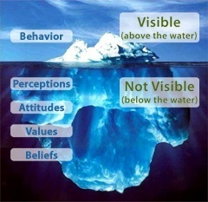
Understanding the issues
Notes:
It is assumed that participants will be aware of change management theories so these next slides are offered as a reminder and to provide ideas for how to frame the task. They focus on understanding how to support people to change behaviours and their role as managers.
It is useful to remember that the way people behave is influenced by a number of ‘unseen’ factors. A common metaphor is that of the ‘cultural iceberg’ where some aspects and behaviours within an organisation are clearly visible and not that difficult to change. The more difficult part is that of the ‘unseen’ elements which – continuing the metaphor – sit beneath the water line and form the bulk of the organisational culture. These are the most potent and harder to shift and include the perceptions, attitudes, values and beliefs which underpin how organisations behave.

Slide 15
Building professional commitment
Pressure
for
change
Capacity
for
change
Bottom of
“in-tray”
Anxiety and frustration
Vision and benefits
Actionable
first
steps
Haphazard efforts
and false starts
A fast start that fizzles out
Notes:
Slide shows pre-requisites for successful PROFESSIONAL motivation. And builds to show the effect when a component is missing – if any of the four boxes is missing then it will be difficult to get professional commitment to change.
Influencing and building commitment to support changes requires rational arguments covering the following key areas:
Pressure for change – What is the compelling reason to change (the burning platform)? How can this proposal compete against others for attention? Is the rationale clearly laid out?
Capacity for change – Without capacity or capability to implement recommendations, then there will be little change. Is this proposal competing against others that also require staff capacity / capability? Is there enough resource available?
Actionable first steps – Any change needs a clear, systematic and logical route – will need to understand the early actions and gain confidence that benefits are being (or will be) delivered. How are you building confidence?
Vision and benefits – A vision is essential to show where the project / organisation / etc is heading, and what the value of achieving the vision is. What vision is the organisation already signed up to, and how does the proposal align to that?

Slide 16
Building personal commitment
Clear and simple
Energy, enthusiasm and hope
Poor understanding and no buy-in
Inertia to change and slow start
Personal goals
Personal style
Bumpy ride and constant challenge
Little personal commitment
Notes:
Slide shows pre-requisites for successful PERSONAL motivation. And builds to show the effect when a component is missing – if any of the four boxes is missing then it will be difficult to get personal commitment to change.
Professional motivations are rational and often task driven, personal motivations tend to be more hidden and difficult to address in a systematic way. In building commitment, you may wish to consider the following personal factors:
Clear and simple – People are often swamped with difficult to navigate information, which can adversely affect decisions. What level of information do you need to provide? How can you ensure that proposals are simple and understood? Does everyone understand your approach and how decisions are evidenced and made? What training are you providing?
Energy, enthusiasm and hope – Support can be slow to galvanise if stakeholders are not engaged with enthusiasm and energy. How are you selling the benefits of change? How are enthusing and leading people to the right conclusions? How are you building expectations and hope that objectives can be met? Can you make use of other stakeholders to bring enthusiasm and galvanise support – e.g. community leaders?
Personal style – What leadership style or culture is dominant? E.g. participative management or authoritarian management.
Participative: Seek wider support and sell the benefits of working differently. Use emotional arguments as well as evidence.
Authoritarian: Generally results driven, so orientate discussion around achieving results using facts and figures to back up argument and cutting out incidental information. Be realistic and always deliver promises. Be constructive and avoid direct confrontation.
Personal Goals – What does the individual want? What personal pressures are they under? What is their career path and how will this change help them achieve that goal?

Slide 17
Styles of leadership
Supportive behaviour
Supporting Person is well experienced but lacks motivation. Needs high support | Coaching Person has more experience but is taking on more demanding work and so feels less confident
Delegating Person has all the technical and people skills needed, is experienced and highly motivated. Can be left happily to get on with it | Directing The person has little experience of the task but high enthusiasm and confidence
Directive behaviour
Notes:
Hersey and Blanchard’s theory of situational leadership (1993) is a practical way to implement the ideas of the role of the line manager on a day-to-day basis (NB this is an appealing model but little evidence to support it!). It is ‘situational’ in that the manager’s behaviour needs to vary from situation to situation, according to the characteristics of the individual staff member. Need to match the leadership behaviour to the development level of the staff member in whatever task they are undertaking.
Directing – the subordinate has little experience of the task but high enthusiasm and confidence. She needs telling what to do, but little support in carrying it out.
Coaching – person has more experience but is taking on more demanding work and so feels less confident. He needs showing what to do, but little support in carrying it out.
Supporting – person is well experienced but lacks motivation. Needs high support.
Delegating – person has all the technical and people skills needed, is experienced and highly motivated. Can be left happily to get on with it.
People’s situation and roles can fluctuate so leader has to respond dynamically. Each subordinate can be in a different place in different situations

Slide 18
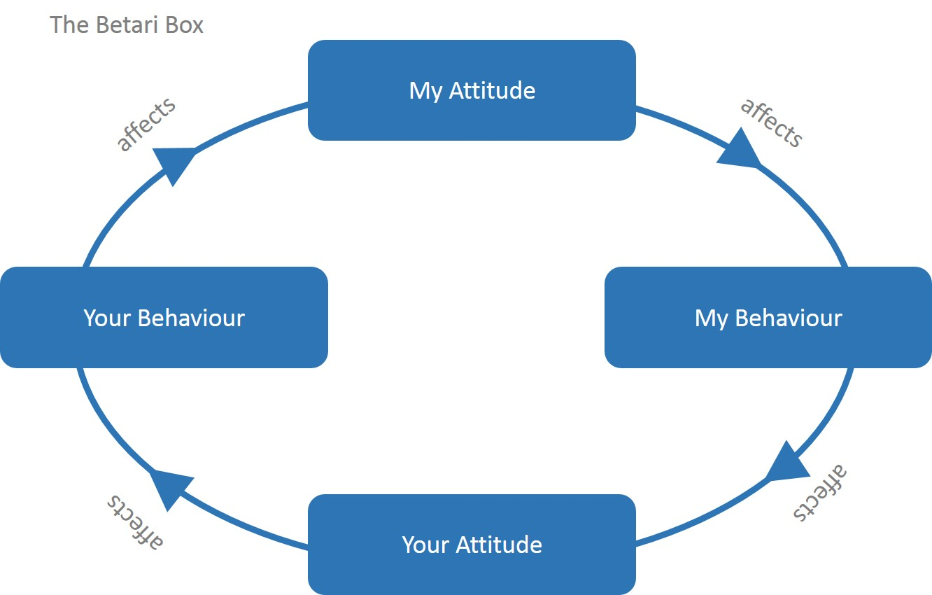
Is it all about “them” or me….?
Notes:
It is important to remember that your own behaviour will have a big impact on that of those you work with. Offer these examples to illustrate these:
Example 1
Imagine your drive to work is very stressful. The longer you sit in traffic, the more frustrated you become – and by the time you get to the office, you're in a negative mood.
Your attitude causes you to use inappropriate negative behaviours. Your temper is short, so you yell at your assistant and then shout at a colleague when you discover a mistake in the report she just gave you.
Your negative behaviour, in turn, affects your assistant and colleague. They are upset by your attitude and behaviour, and they then repeat them in other negative ways. Your assistant is sulky and unhelpful for the next few hours, and your colleague is sarcastic and resentful towards you as well. No real communication takes place.
Example 2
Imagine it's just after lunch. You've had your negative drive into work, and you've already yelled at your assistant and your colleague.
As you sit at your desk angry, you realise this all started with something incredibly silly: your drive into work. After thinking about this, you decide to exit the cycle. You begin by offering your assistant a genuine apology, which he accepts with a smile. You also apologise to your colleague and offer to work with her on the report to improve it. She also accepts your apology and thanks you for being willing to help fix her mistake.
The end result: productive, meaningful communication can now take place, simply because you were willing to stop your negative thinking and step out of the cycle.
Example 3
The next day, your commute is just as bad, but you use relaxation techniques in your car, and you make a real effort to be positive as you go into the office. You greet your assistant and your colleague warmly. Soon they're pleasant back to you, and you all have a positive, enjoyable, productive day.
Key points
The Betari Box illustrates how our own attitudes and behaviours directly affect the attitudes and behaviours of people around us. When we're stuck in a negative cycle, then it's up to us to stop that cycle by changing our attitude. This will positively impact those around us – and therefore break the cycle.

Slide 19
Consider:
Direct actions, such as: changing supervision approaches with staff, arranging different activities with providers, providing information and training
Indirect actions, such as: modelling required behaviours, influencing leaders, rewarding success, providing space to learn from mistakes
For example:
Are there people who would be natural champions of the change?
Are there events taking place at which your message can be heard and supported?
Will you need to change your own approaches and behaviours?
How will you tackle resistance?
Notes:
When planning to implement culture change it is important to consider both direct and indirect actions, and to think through potential opportunities that could enable change, as well as barriers to change.

Slide 20
Planning for change
How will you deliver the vision you have described?
What approaches can you take?
Notes:
Within their themed groups plan what they will do to deliver the culture change they have described. Headlines only. Encourage the group to challenge each other to think outside the box and focus on solutions.

Slide 21
Planning ahead
Each group to present headlines of action plans with a brief rationale for taking the approach they have agreed
Feedback from whole group:
What ideas did they find most useful for them locally
What approaches have they tried themselves and what learning could they offer others to make sure they work
Notes:
Facilitator to ask for a brief presentation (3 or 4 minutes) from each group setting out the headlines of the actions they have discussed.
At the end of the presentations, the facilitator is to ask each person in the room (or volunteers) to comment on either one idea they liked or would find useful, or one approach they have tried themselves and a learning point to offer the group. The intention is to identify positives and/or opportunities for the group to take into their own planning.

Slide 22
Planning next steps
Revisiting original pre-workshop exercise:
What do you need to do as a priority action to take the cultural change forward?
What do you see as the main opportunity locally for moving on with the implementation of the Act?
Notes:
Ask everyone to spend five minutes individually thinking about what they will take away to do, and identify the main opportunity for moving on locally. Then ask them to share these with their neighbour.
If there is time, ask for feedback on the opportunities identified.

Slide 23
Moving on
Evaluation sheet
Plans for second workshop “Measuring Progress”
Date and other arrangements
Reminder about the pre-workshop exercise
Notes:
Add relevant details about the next workshop including the date, venue and the requirement for the pre-workshop exercise which will be used during the workshop.
Remind each participant to fill in an evaluation sheet.

