Slide 1

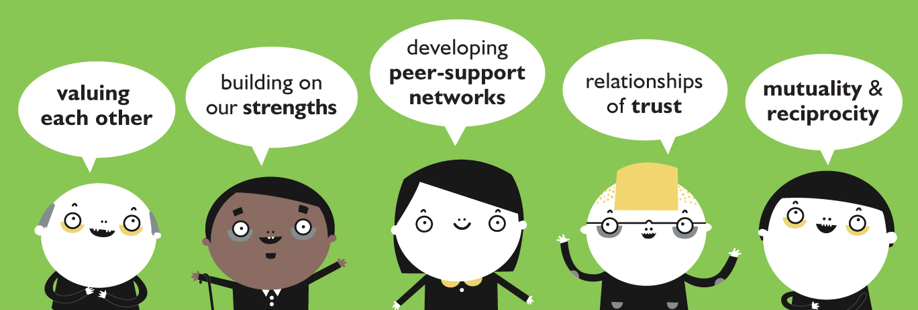
Co-production in health & social care: what, why, how
Ruth Dineen | Noreen Blanluet
ruth@coproductionwales.com & hello@noreenblanluet.co.uk

Slide 2
an asset-based approach to public services which enables citizens and professionals to share power & work together in equal and reciprocal relationships
Co-production:
what?
Notes:
Generally accepted definition: the key issue is power and who has it.
Equality = of voice, decision-making, access to budgets, agenda-setting…
Reciprocity = opportunities to contribute, opportunities to benefit for all participants; not a one-way street.

Slide 3

the core economy
the core economy is made up of countless under-valued and priceless human and social assets that make it possible for society to flourish
[Neva Godwin & Edgar Cahn]
Glyncoch Community Regeneration
Community Voice . Communities First
Oxfam Sustainable Livelihoods . Spice Timebank
Notes:
Co-production draws on a range of good practice, all based on an understanding and appreciation of what's known as the 'core economy' - a term coined by economist Neva Goodwin and developed by US civil rights lawyer and social activist Edgar Cahn.
The Core Economy is the economy of friends, family, relationships – the relationships that keep society functioning.

Slide 4
the core economy
‘provides care to infants, children, teenagers, families, seniors.
It provides safe, vibrant neighbourhoods, community, democracy, civil society.
It produces love and caring and coming to
each other’s rescue and sharing. That's all…’
Edgar Cahn
Notes:
and like any economy it produces things - here's Edgar Cahn's explanation...
This isn’t just about being nice to each other…the core economy has a direct impact on the money economy e.g.
grandparents looking after grandchildren saved state £365K in Wales in 2013: 1/4 of parents in work can only do so because of this support; 12million hours of social care are provided by the state alongside 288million hours of voluntary ‘core economy’ care; estimated maximum 20% of our education (in broadest sense) comes from school - remainder is from the core economy.
Co-production works by recognising, valuing and nurturing these abundant human resources and by making more and better use of them to meet our shared needs.

Slide 5
Co-production principles
value participants as equals and assets
build on strengths
develop peer-support networks
personal outcomes focus
relationships of trust & reciprocity
facilitation not delivery
Notes:
And it does this through the systematic application of a number of key principles…
If a service is co-produced, all these principles will be in place – assets / strengths / networks / outcomes / relationships / facilitation.

Slide 6
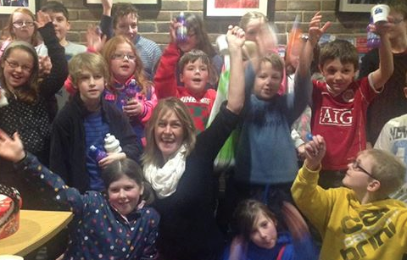
Co-production aims
vibrant & confident core economy
shared power | shared responsibility
social justice
Powys Young Carers
Notes:
Co-pro isn't just about delivering better services - although it does that. The aims are much more ambitious and radical...
Shared power is the key…this is the major culture and behaviour change that’s required – by government and public service organisations. But power (and responsibility) can only be shared if citizens have the necessary confidence and capacity i.e. if they are participants in a thriving core economy.
Co-pro begins by building and valuing the core economy, the first step in a journey towards social justice.

Slide 7
what co-pro isn’t…
[assumption alert]
Notes:
There are lots of assumptions about co-pro, and the term is used in all sorts of different ways, several of them with negative connotations. It’s important to understand what co-pro isn’t in order to ensure that the radicalism doesn’t get diluted or subverted in practice.

Slide 8
We’re already doing it…
Levels of co-production
basic
acknowledges people's action is essential
to the desired outcome
intermediate
recognises what service users can offer services
power imbalance remains in place
transformative
citizens are equal partners in all aspects of commissioning, design, delivery, evaluation
transforms power and control
Needham & Carr, 2009
Notes:
Assumption 1 – we’re already doing it
Needham & Carr levels of co-pro: How power is distributed between people getting support and the people who deliver it.
Basic – no shared power just compliance
Intermediate – only goes as far as recognising the skills that are useful to a particular service
Transformative – it’s about people living good lives (on their own terms) not being fitted into services

Slide 9
It’s just about saving money…
The cuts scenario
Substitutive co-production: public sector inputs are replaced with inputs that come from users and/or communities
The transformation scenario
Additive co-production: public sector resources are combined with individual and community resources
New Economics Foundation
Notes:
Assumption 2 (neo-liberalism / Big Society)
Back to the issue of who has the power / who has the responsibility?
Co-production is not an excuse for cutting back on services and leaving citizens to sink or swim (although it can be presented in this way).
Additive – true co-production; the sum is greater than the parts.

Slide 10
It’s just another word for… consultation / collaboration / partnerships
 |  | Who designs?
 |  | Professionals design services | People & professionals together | People design services
Who delivers? | Professionals deliver services | traditional service model | co-designed services
 | Professionals & people together | co-delivered services | CO-PRODUCED SERVICES
 | People deliver services | people trained to deliver services |  | self-organised community provision
New Economics Foundation
Notes:
Assumption 3. It’s just a rebranding exercise: another word for consultation, collaboration etc
The grid helps clarify the difference…focus is on who has the power, who’s agenda is it, and who has the responsibility.
Co-production = PARTNERSHIP between frontline professionals and people using services.

Slide 11
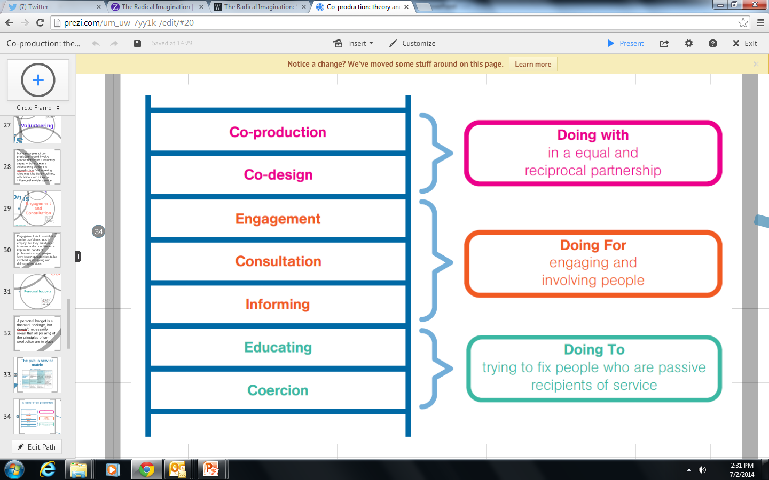
It’s just another word for… engagement / participation
Engagement ladder: who has the power? whose agenda is it?
Arnstein / NEF
Notes:
Assumption 4 - just another word for engagement/participation
Version of Arnstein’s engagement ladder – with the addition of co-design and co-production as ‘turbo-charged’ engagement. Check who has the power and whose agenda it is in order to determine where on the ladder a project or initiative might sit.
Most initiatives will span several rungs of the ladder – the aim of transformative co-pro is to remain always in the ‘doing with’ section.

Slide 12
decreasing budgets fewer staff increasing demand
Co-production:
why?
the problem…
Notes:
Co-production - why?
Co-pro requires culture change – it’s a big ask. So why do it?
Many reasons…
because we need to (austerity)
have to (legislation & policy)
because we want to (values) - it’s the right thing to do
Start with the problems we’re all facing... reasonable to assume that if we pool all our resources and work together we might address some of these issues.
Example of the Wallich – works co-productively with homeless people across Wales - c250 staff, 100 traditional volunteers, over 500 service user volunteers co-producing e.g. quality improvement & evaluation policies and processes, recruitment policy (with full participation in recruitment process), rough-sleeper city guides, project guidelines, design and delivery etc.

Slide 13
the bigger problem…
The world of helping others is built around one-way transactions which send two unintentional messages:
We have something you need,
but you have nothing we need or want or value.
The way to get more help is by
coming back with more problems. Edgar Cahn
Notes:
But there’s a bigger problem…the ‘professional gift model’
Recipient is seen as passive, helpless and needy. Not only do they have a problem – they ARE the problem.

Slide 14
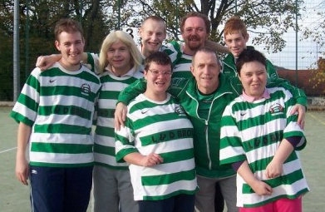
Dimensions Cymru
we understand ourselves, our identities, through our relationships with others…
Nunkoosing & Haydon-Laurelut, 2013
Notes:
This view of service users is particularly significant since 'we understand ourselves, our identities through our relationships with others'. If we are always cast as the passive recipient of someone else's expertise and largess, we will lose confidence, self-belief and will actually become passive and helpless.

Slide 15
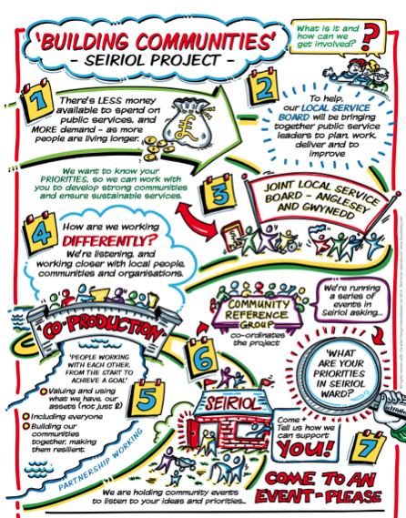
Co-production
one-way transactions > reciprocal relationships
strong core economy
shared power
shared responsibility
Seiriol Building Communities
project
Notes:
Co-pro deals with this issue head on - making a shift from one-way transactions to reciprocal and equal relationships. That builds confidence and capacity and reinvigorates the core economy. And that creates a context where shared power and shared responsibility can become a reality.

Slide 16
Co-production:
why else?
because we have to!
Social Services & Wellbeing (Wales) Act 2014
Co-production principles embedded in mandatory code of practice
Co-produced commissioning: equal partnerships –
service-recipients, staff & wider communities
Co-produced assessment: what does a good life mean to you? what strengths can we build on?
Co-produced evaluation: from KPIs to personal outcomes
[National Outcomes Framework]
Notes:
The policy and legislative context in Wales both encourages and demands a more co-productive approach.

Slide 17
Co-production:
why else?
because we have to!
Essential to fulfilling the duty of the Act will be an approach which:
Recognises people as assets, having a positive contribution to make to the design and operation of services
Supports and empowers people to get involved with the design and operation of services
Empowers people to take responsibility for, and contribute to, their own well-being
Ensures that practitioners work in partnership with people to achieve personal outcomes at an individual and service level
Involves people in designing outcomes for services.
Notes:
Here’s the detail from the mandatory Code…

Slide 18
Co-production:
why else?
and…
Guidance on working with Communities
involve communities, service users and organisations in defining problems and in the identification, design, delivery and evaluation of new approaches
recognition of shared responsibility to improve public services, focused on outcomes and assets
Prudent Healthcare
Achieve health & wellbeing with the public, patients and professionals as equal partners through co-production
Notes:
And in other policy areas…

Slide 19
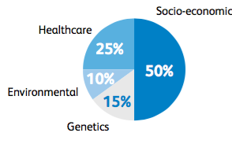
Co-production:
why else?
and…
Chief Medical Officer’s Report 2016
Rebalancing healthcare:
working in partnership to reduce social inequality
Bunker et al 1995
Notes:
The recent CMO’s report focuses on the social aspects of health (the core economy) with an appreciation that formal healthcare services contribute a relatively small amount to our overall health and wellbeing
(see report for other relevant statistics)

Slide 20
Co-production:
why else?
and…
Chief Medical Officer’s Report 2016: Recommendations
Primary & community care services to work
co-productively with local communities to manage
demand on GP services through:
Co-producing primary care
Social prescribing
Time banking
Health services research programme to evaluate social models of care e.g.
Co-production for health protection
Co-pro and primary health demand
Time banking & communities
Notes:
The recommendations include focus on the need to work together to co-produce health and wellbeing, and on a new health services research programme led by the deputy CMO Chris Jones which will be evaluating social models of care.

Slide 21
Co-production:
why else?
and…
Well-being of Future Generations Act: goals
prosperous . resilient . healthier . more equal . cohesive communities . vibrant culture & language . globally responsible
National indicators to measure progress towards goals
Public sector to develop specific objectives to meet goals, based on…
    WFG principles:
        Long-term thinking
        Prevention
        Integration
        Collaboration
        Involvement

Slide 22
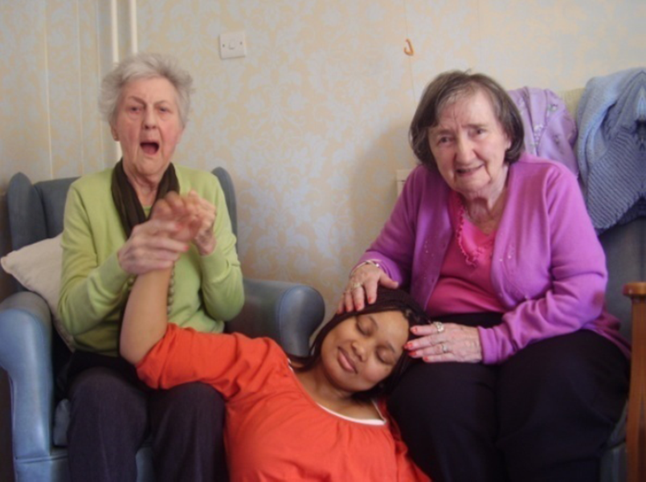
Co-production:
why else?
because it works!
My Home Life Cymru
Notes:
Final reason is because it works!
Co-pro transforms peoples' lives...

Slide 23

Connecting Communities - Falmouth
post natal depression
childhood asthma
teenage pregnancy
child protection rates
overall crime rate
unemployment
educational attainment
down 70%
down 50%
down to zero
down 42%
down 50%
down 71%
up 100%
Notes:
Evidence from an Exeter University evaluation of the ‘Connecting Communities’ co-pro approach in 3 communities in Falmouth over a 3-year period.

Slide 24

Connecting Communities - Falmouth
savings 3.8 - 6.4 : 1
TR14ers
Through dance we can change ourselves, others, and the communities of which we are a part…
Notes:
savings through early action / prevention
More powerful is what’s behind the statistics…
4 main areas of leverage if you want to persuade someone to give co-pro a go:
legal requirement; budget savings (albeit not immediate); stats re wider impact; values-based.

Slide 25
Co-production - impact
increased engagement & social capital
genuine empowerment & ownership
improved health & well-being
stronger, more cohesive communities
more relevant and effective services
sustainability & value for money
happier, more fulfilled staff
Notes:
There’s growing evidence of the efficacy of co-production and its impact on all participants…

Slide 26
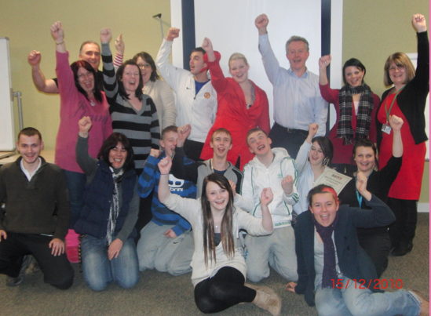
Bron Afon
Youth Forum
Own 2 Feet
Trade that Works
Transition housing project for/by young people in care
refurbished a derelict property through apprenticeships
40% of participants now in sustainable employment
co-produced Allocations & Management policy/systems
co-produced Own 2 Feet training programme
61% failed tenancies > 100% successful tenancies
Notes:
And plentiful evidence in practice…
(Bron Afon example is in the Co-production Catalogue)

Slide 27
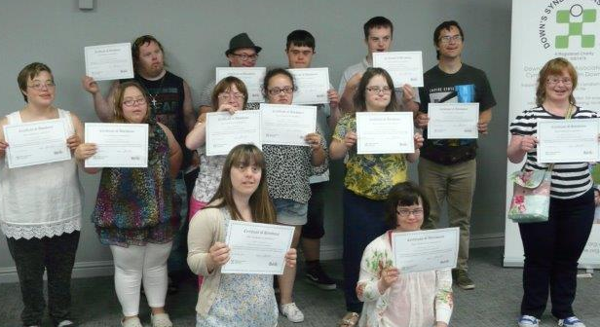
Tell it Right
Down’s
Syndrome
Association
’thought I had a good level of knowledge…
but this has been so enlightening’
‘very powerful – made real by meeting adults
with Down’s Syndrome’
'big impact on my personal feelings and knowledge’
Notes:
The NHS are currently introducing a new non-invasive pre-natal screening test for Down’s syndrome. There is concern that, without up-to-date and accurate information about Down’s syndrome, pregnant women might not receive balanced information.
Down’s Syndrome Association staff worked with 15 adults with Down’s syndrome to design training content for a full-day course to be delivered to midwives, pediatricians and obstetricians across Wales. Now accredited by the Royal College of Midwives and is co-delivered by adults with Down’s syndrome.

Slide 28
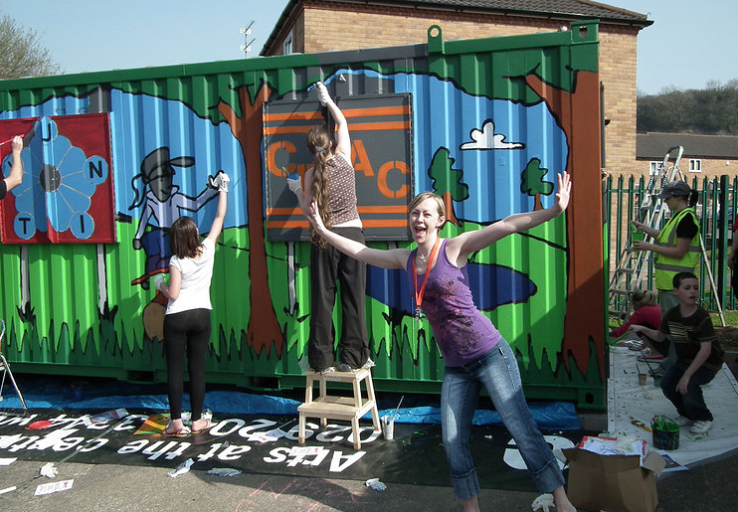
Action in Caerau & Ely (ACE)
31,000+ hours volunteering / 80+ community groups
Community Ambassadors / Community Health Strategy
86% stronger networks
77% greater quality of life
60% healthier
26% less social care support
50% of organisations >
improved services
same/fewer resources
Notes:
ACE is a social enterprise linked to a Spice timebank and located in a Communities First area. For more information and current evaluations see www.justaddspice.org/ and/or the Co-production Catalogue.

Slide 29
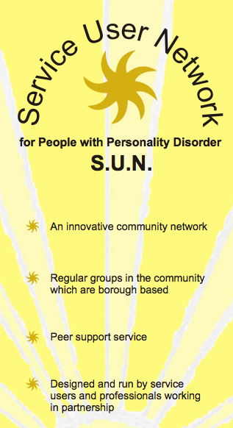
S.U.N. Service User Network
A&E use down 30%
planned hospital admissions
down from 725 > 596
unplanned hospital admissions
down from 414 > 286
hospital bed day use
down by 50%
Notes:
The Service User Network known as S.U.N is based in Croydon, London. It’s a support network developed for and by people with personality disorders in Croydon. Members of the network share similar experiences and support one another in formal and informal ways. They use peer support networks to improve people’s coping strategies and help each other during times of crisis. Research has shown that since becoming members of S.U.N. people’s use of hospital beds has halved after six months and A&E use has decreased by 30%.

Slide 30
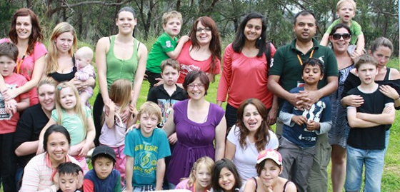
Family by Family
90% = 'heaps better'
savings 7:1
Notes:
Family by Family is an approach developed in South Australia by the Australian Centre for Social Innovation. Focusing on those in crisis, it aims to support more families to thrive and fewer to come into contact with crisis services. It was co-designed with the families involved and is co-delivered and co-evaluated by them. It creates family based peer networks linking ‘seeking’ families with ‘sharing’ families. It sees families as the experts and provides them with support in order that they can support one another.
Evaluations have shown that the approach is successful in keeping children out of care, is very popular with the families involved and saves $7 for every $1 invested.

Slide 31
1. Build from strengths appreciative inquiry approach
2. Use your assets
‘if we use what we have, we have what we need’
3. Do what matters from outputs to personal outcomes
Co-production: how?
Notes:
There isn’t a model for ‘doing’ co-pro but there are some key elements…
1. Build from strengths
2. Use your assets
3. Do what matters - from outputs to personal outcomes

Slide 32
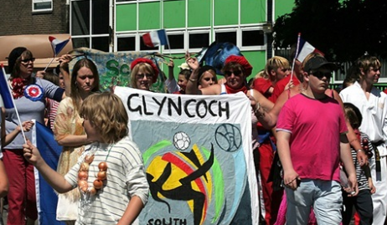
What do we already know?
What do we already do well?
How can we do more of it?
1. Build from strengths
an appreciative inquiry approach
Glyncoch Community Regeneration

Slide 33
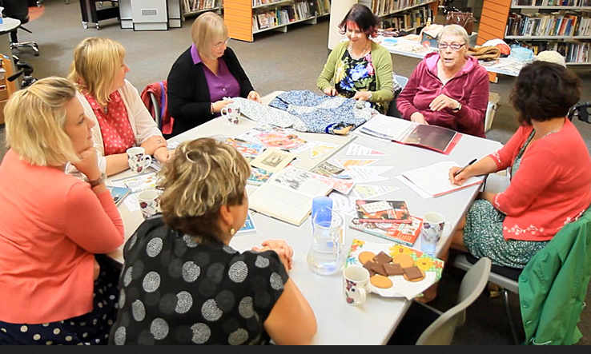
map them value them nurture them use them!
2. Use your assets
if we use what we have, we have what we need
Monmouth Community Connectors
Notes:
Use your assets
An asset is anything that helps us live a good life, anything that increases our confidence, capacity, wellbeing and resilience. Co-pro is predicated on assets - mapping them, valuing them, nurturing them and, most importantly, using them!

Slide 34
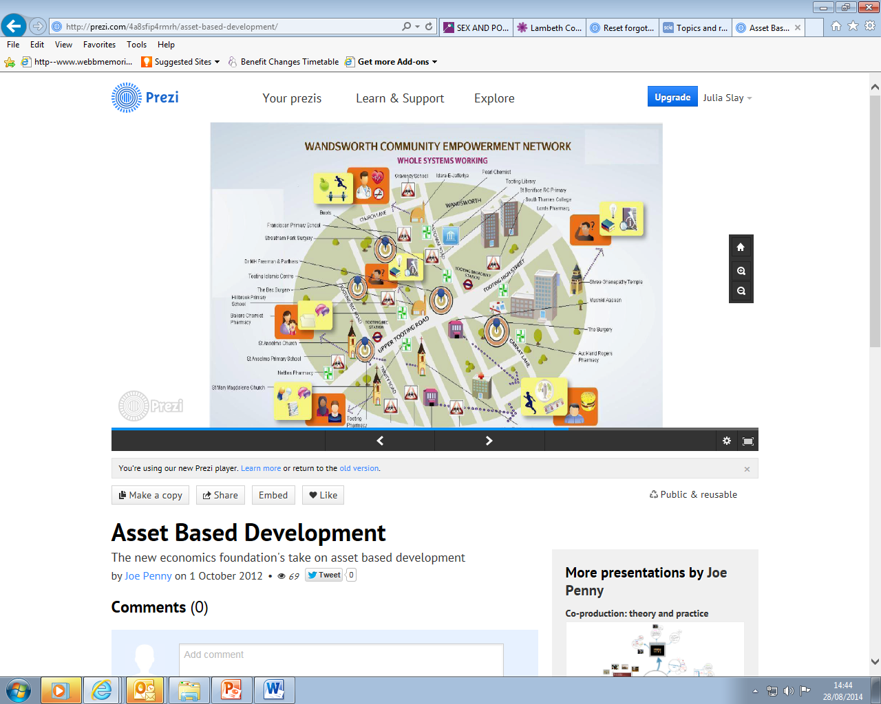
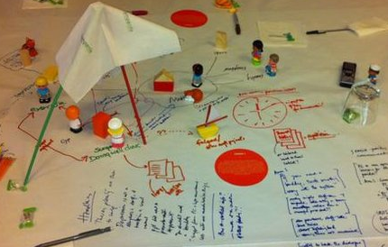
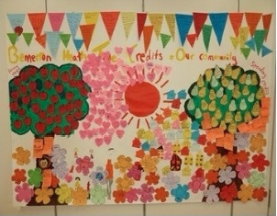
Mapping our assets
people (head, hand, heart)
networks (personal, professional)
groups & activities
places & spaces
resources (including transport)
Notes:
Examples of asset mapping…cf core economy
NB your biggest assets are those you support and their families.

Slide 35
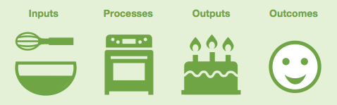
3. Do what matters
from outputs to personal outcomes
Talking Points
outputs - what the system does
outcomes - the effect it has / the difference it makes
personal outcomes – who decides?
Notes:
Information for the following four slides was taken from the Scottish Government’s ‘Talking Points’ integrated assessment initiative. Extensive info is available online.

Slide 36
who has the power? / who’s the expert?
assessment model | who's the expert? | service response
procedural model | the agency + its associated processes & forms | allocated: little opportunity for innovation or flexibility
questioning model | the professional | imparted as from expert to novice
exchange model | everyone is an expert, but in different ways | negotiated between partners – opportunities for reciprocity and innovation
Notes:
Back to the issue of power - who's the expert / whose opinion counts?
Variants clarified by this model of assessment:
Co-pro uses the exchange model

Slide 37
personal > project > organisational > national outcomes
outcome level | example
individual / personal | 'I want to be able to get back to the bowling club with my mates.'
service/project | We work with older people to improve their ability to get out and about.
organisational | We will improve the social inclusion of the older people we work with.
national | We live longer, healthier lives. People are able to maintain independence as they get older and access support as they need it.
Notes:
Once the service response is agreed, that personal outcome is used to inform project outcomes, organisational outcomes and national outcomes.
Bottom up not top down. What matters to the individual.

Slide 38
Scotland: Talking Points Framework
health & social care: assessment model
Quality of life Process Change
feeling safe listened to improved confidence
having things to do having a say improved skills
seeing people treated with respect improved mobility
feeling well treated as an individual reduced symptoms
living where you want being responded to improved wellbeing
& as you want
Notes:
Outcomes Framework from Scotland Talking Points integrated assessment model based on over 20 years of research – measured by progress towards the individual’s goals (which may change over time).

Slide 39
National Outcomes Framework
I'm listened to and supported
People value my opinion & choices
I feel confident & respected
I'm empowered to make my own decisions
I have opportunities & choices
I have good relationships and a good social life
I can learn & develop my full potential
I can make a difference & contribute to my community
Notes:
Compare with Wales National Outcomes Framework (cf Gwalia and NPT Homes)
If co-pro is to become a reality we need to begin with personal outcomes – doing what matters – for both commissioning and assessment. We then measure service quality by progress towards these goals. If the Welsh Government is serious about co-pro, they need to change the commissioning landscape to create a context in which this can happen. And if we are serious, we need to insist that they do so.

Slide 40
Gwalia Homes
& JRF
(Developing
Evidence Enriched Practice)
"good places to live, love, dream, laugh, learn
and connect with others…a true community"
security . continuity . belonging .
purpose . fulfilment . significance
Notes:
Personal outcomes from care home residents. JRF DEEP research project… more detail available online or contact Nick Andrews of Swansea University’s School of Social Care Research.

Slide 41
Do it together – from the start!
2.40
Notes:
And above all else…
Do it together, equal partners from the start!

Slide 42
Co-production will…
‘restore warm humanity as the driving force for public services, rather than compliance with increasingly centralised and
de-personalised processes and systems’ Nick Andrews, Swansea University
thank you!
Ruth Dineen | Noreen Blanluet
ruth@coproductionwales.com & hello@noreenblanluet.co.uk
Notes:
Just a reminder of what it’s all about from a stalwart co-pro champion…

