Slide 1
Part 2: Assessment
Notes:
This slide to be shown as participants enter the room.

Slide 2
Notes:
This slide may be shown when welcoming everyone to the course and performing introductions. Before starting the course, it is common for the facilitator to provide instruction on:
Location of facilities
Fire alarms and exits
Use of mobile phones
Taking of notes
Arrangement of groups
Tea/coffee break
Course evaluation forms
The exact details required here will depend on the venue. The facilitator should know if a fire alarm test is due but should anyway indicate fire exits and procedures, the location of toilets and arrangements for the break and the organisation of seating within the room.
The availability (or not) of a hearing loop should be noted. People with a visual impairment should be invited to come closer to the front. It may be necessary to ask if everyone is warm enough, or if they want any windows to be opened.
If translation facilities are to be provided, then people who will require translation should be invited to collect a headset and to check that they are functioning correctly.

Slide 3
Introduction

Slide 4
Course programme (1)
Session 1 – Assessment of individual’s care and support needs; and identify hazards and obstacles to positive outcomes
Session 2 – Linking conditions, issues and risks; using technology to confirm lifestyle and unmet needs
Break
Notes:
This slide (and the next) may be omitted and replaced with a handout or included in the advertised programme for the day.
The timings will depend both on the time available, and the speed required for delivery, and on the inclusion (or omission) or groups of slides relevant to particular participants or which are intended for local consumption.
The course has been split into four sessions each of approximately 45 minutes duration (though flexible). Sessions 2 and 3 are separated by a 15 minute refreshment and toilet break.
Timings may be altered by + or – 15 minutes according to local preferences or to run during the morning when a 9-15pm registration would allow the course to end at 12.45pm.
It is unlikely that the course could be run in under three hours if appropriate discussions are included. With longer breaks, and group and open class discussion, and with most of the optional content included, the course could take a whole day (i.e. six hours)

Slide 5
Course programme (2)
Session 3 – Models of service provision and additional assessment considerations
Session 4 – Case studies and exercises; preparing for the future
Review, Q&A

Slide 6
Learning objectives (1)
Appreciate how a person-centred approach to assessment changes priorities and outcomes that are possible through innovative support measures
Recognise that people need individual support from technology – new models are needed to meet their preferences, lifestyle and homes
Notes:
This slide, and the next, presents five aims for the day and should need little explanation.

Slide 7
Learning objectives (2)
Have the skills to relate issues to the technologies that work for people with different knowledge and experiences of Information Technology (IT)
Be able to perform robust risk assessments to show how telecare can reduce the likelihood of accident and the extent of harm to individuals
Know how to help people discover new ways of supporting themselves or others using technology

Slide 8
Session 1: Profiling the individual

Slide 9
Person-centred care
is…
Person-centred
Strengths-based
Skill acquisition
Collaboration
Community integration
Quality of life
Community-based
Empowerment/choices
Least restrictive
Preventive
Abilities
is not…
Practitioner-based
Problem-based
Deficit focus
Professional dominance
Acute treatment
Cure/improvement
Facility based
Dependence
Episodic
Reactive
This can help answer the question:
“What matters to you?”
Goals
Interests
Care is personalised
Care is coordinated
Care is
enabling
Values
Family
Person is treated with … dignity, compassion and respect
Notes:
This slide is animated.
This slide provides a reminder of the context for assessment – focusing on an individual’s personal goals and abilities (rather than disabilities), their interests, their family and their values which collectively govern how they want to live their lives, and provides the motivation for interventions that can improve quality of life and well-being.
The Social Services and Well-being (Wales) Act 2014 requires the adoption of person-centred care principles.
This includes looking at people’s preferences, abilities, interest, goals, families, and values in working out their care and support needs.
This means empowering the individual to improve their quality of life through a more preventive and collaborative approach which embraces their own strengths and assets. This, quite rightly, leads to higher expectations and personalised provision including the ability to take risks based on informed consent.
It also encourages the use of technology – especially as devices have become smaller, lighter, more reliable and more aesthetically pleasing.

Slide 10
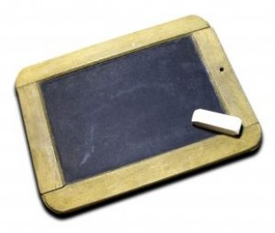
Profiling
Knowing me
Bucket list
Obstacles
Technology use
Notes:
This slide is optional.
Developing a profile of a person is the easiest way to get to know them. A bucket list is often used today as a way of describing someone’s ambitions i.e. what matters most to them or their aims in life. Most people are unable to complete their bucket list because of the obstacles that lie in their way. Our aim is to introduce technology as an effective and accessible means of addressing these obstacles or issues.
It gives an opportunity to describe an example, such as the one offered below.
A lady aged 88 from Liverpool knew that she was in the final years of her life; she was suffering from bronchitis and a chronic airways disease which meant that she struggled to breathe and used oxygen routinely. When asked if there was anything that she wanted to do in the next month, she replied that she wanted to visit the house in Newcastle where she and her deceased husband first lived when they were married 66 years ago. She knew that it would be impossible because she would be unable to make it to the railway station, let alone travel on a train for several hours. Because she knew the street that she wanted to visit, her support worker was able to take her on a virtual tour of Newcastle ending up outside her old family home using Google Streetview on his laptop. She was staggered, and shouted out that the door has changed “It’s now white and it was always black when we lived there”. She told every one of her friends about her experience and told them all that she could now die happy.

Slide 11
National minimum core data set (1)
NHS Number
Title
Surname
Forename(s)
Preferred Name
Address and Post code
Date of birth
Telephone
E-mail Address
Gender
GP surgery name and address
School name and address (for children)
Occupation
Notes:
This slide, and the next, shows the basic questions that need to be answered in developing the profile of an individual according to the Code of Practice on Assessing the Needs of Individuals from The Social Services and Well-being (Wales) Act 2014 National Assessment and Eligibility Tool. Additional core data can be added if relevant to the circumstances and needs of the individual.
The obligation to complete the core data set in its entirety is only required to be met when an individual’s needs are deemed to be eligible and a care and support plan, or support plan in respect of a carer, is required.
In particular, if the individual has a family carer, it needs to be established if they are willing and able to carry on providing support.
The facilitator needs to emphasise that an assessment should be integrated without the need for a separate one for technology.

Slide 12
National minimum core data set (2)
What other assessments have been undertaken by other agencies?
Preferred language / communication method / accessibility requirements
Name(s) of carer(s) / people with parental responsibility
Relationship
Contact details for carer(s) / people with parental responsibility
Is this a child on the Child Protection Register?
Contact details of lead assessment co-ordinator (the person doing the assessment, and who they work for)
We need to highlight how technology can fit into an
Integrated Assessment Framework
Notes:
This slide is animated.

Slide 13
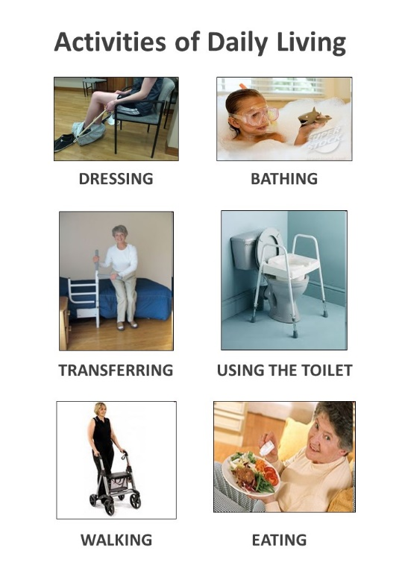
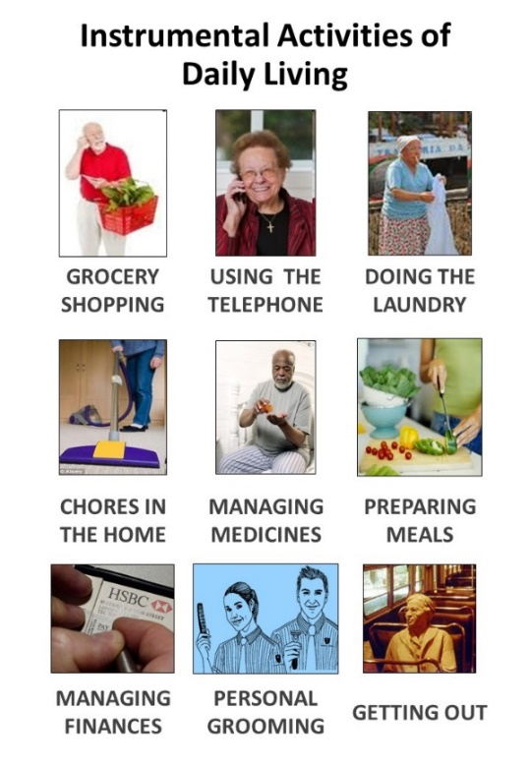
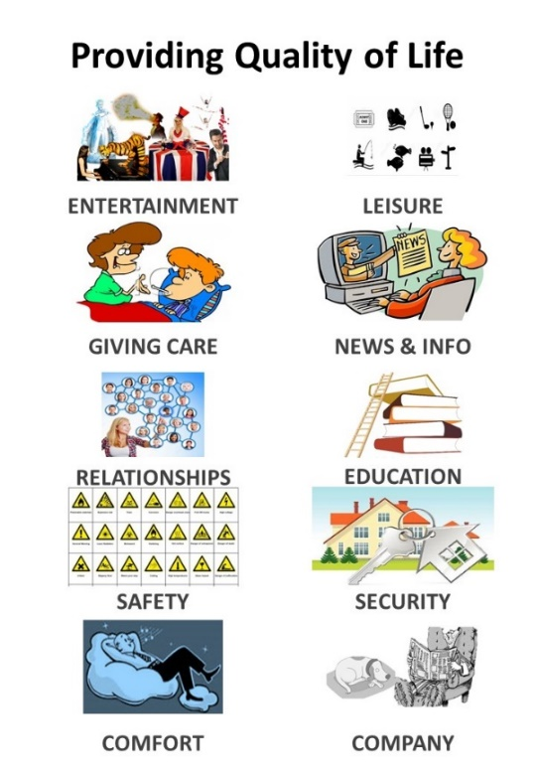
Exercise – the technology we use everyday
Where does your home technology fit?
Notes:
Participants are split into teams of four or five, each team assembled around a table. The teams are invited to write down as many items of home technology that they can think of, and attach the post-it notes over the appropriate activity or domain on their chart. They are allowed 10 minutes. At the end of this time, the facilitator asks each team in turn to announce how many items they have on each of the three sections of the poster. They are also asked to identify which of the activities has not been associated with an item of technology.
The facilitator is able to use the results to show that technology can help with most of the Instrumental Activities of Daily Living and with most ways of providing quality of life, but there are few devices that are yet able to routinely help with ADLs. This is why there is such a demand for domiciliary care services, and how this demand will increase in the future as the population ages unless we can find a technology that can help us perform more personal tasks.

Slide 14
Profiling and assessment (1)
How much can we find out about the person?
What can we ask that isn’t intrusive?
Who keeps the data?
How can people share the information?
How can we change or add to the data?
Notes:
This slide, and the next two, ask a series of questions about profiling, only some of which can be answered. It should be apparent that asking these questions can be onerous, especially if people are asked the same questions over and over again.
The focus on goals allows the individual to be honest about their dreams and of practical matters that concern them, and also give them a chance to state their preferences regarding where they live, how they are looked after.
Finally, there are many obstacles or things that get in the way of us improving our lives. They include illnesses, disabilities but are also problems with our homes, the support we get from family, friends and neighbours, and the ways that they embrace technology.

Slide 15
Profiling and assessment (2)
Must focus on goals rather than basic needs:
Dreams and aspirations
Practical concerns (including money)
Preferences

Slide 16
Profiling and assessment (3)
Need to understand the obstacles:
Ill-health
Long-term conditions
Disability (physical, cognitive, sensory, communication)
Home environment (safety, stairs, damp, facilities)
Family support
Technology and IT literacy

Slide 17
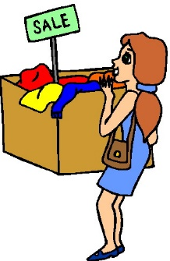
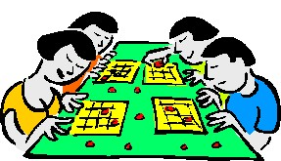
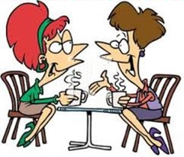
Goals and ambitions
Travel
Parties
Shopping
Going out
Relationships
Bingo
Having a chat
Drinking
Notes:
This slide may be excluded.
It is animated and serves as an introduction to profiling John – an individual who can be used as an example to consider.
It shows eight examples of goals, dreams or ambitions. A simple profiling exercise allows the user to select relevant goals by ticking them of by drawing a ring around them. So let’s imagine that John wants to go out more often for a drink, and to meet more women.

Slide 18
The home
Neighbourhood
Happy?
No. of rooms
Type
Neighbours
Garden
Transport
Safety
Amenities
Utilities
Decoration
Lighting
Bathroom
Heating
Damp
Notes:
This slide is may be omitted.
It is animated, and offers descriptions of the home which can be selected in the same was as in the previous slide. It allows some simple discussion around important factors in the home that could make it desirable or a problem for the person to live comfortably there.
Imagine that John lives in a flat in the middle of town.
John may like his home because it’s in a nice neighbourhood and he gets on well with his neighbours. The flat could do with better lighting but has central heating which makes it comfortable even in winter. This leads on to a more formal exercise in surveying a property.

Slide 19
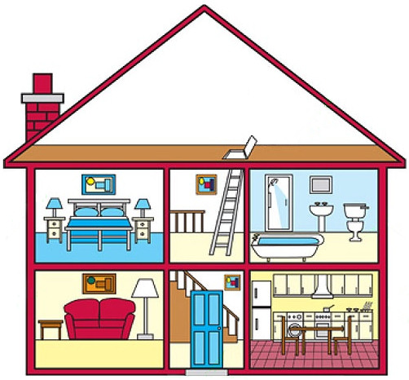
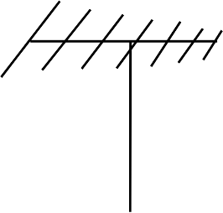
Surveying the home
Utilities:
Water
Electricity
Gas
Telecommunications
Wi-Fi
Digital TV
Bathroom:
Panic alarm
Flood evidence
Grab rails
Temperature gauge
Flooring materials
Walking aids
Kitchen:
State of cooking appliances
Chip pan
Fire blanket
Fire extinguisher
Stop-cocks
Power sockets
Evidence of incidents
Living room:
Clutter
Worn carpets
Poor lighting
Alcohol use
Digital devices
Trip hazards
Medication box
Bedroom:
Lights
Height of bed
Standing aids
Smoking materials
Smoke alarm
Slippers
Telephone
Outside:
Access points
Security lights
Door and window locks
Peephole viewer
Steps
State of drive
Grab rails
Alarms
Type of neighbourhood
Notes:
The slide is animated.
It allows participants to suggest things that could be checked on a room by room basis in a home survey and which would be relevant to profiling an individual in order to assess the opportunities for technology to play a role in their support.
It should begin with a consideration of the utilities and whether they have Wi-Fi (and a landline), and the state of the gas and water pipes (including the location of the stop-cock), the type of TV service received (aerial or satellite) and the strength of the mobile signal (this is for visiting staff as well as for using mobile devices for care). The outside is then considered (front and back gardens and their size), with an emphasis on ease of access (such as steps and trip hazards), existing support (such as ramps and grab rails), and security elements such as lights, locks, alarms and peepholes.
Each of the four main rooms is considered in turn – the bathroom, the bedroom, the kitchen and the living room. The list of possible hazards and points to look for should not be exhaustive but sufficient time should be given to ensure that the importance of the home survey is emphasised. Home surveys aren’t always possible – for example, when someone requires technology as part of the enablement package to return home from hospital after a period of illness or following surgery or an injury. Installers may look at the home or the property could be surveyed at a point of reassessment after the period of enablement.

Slide 20
Life threads
Work
Schools
Interests
Favourite music
Favourite drink
Favourite town
Favourite singers
Favourite sport
First language
Favourite football team
Magazines or books
Favourite food
Favourite film stars
Favourite
film
Favourite reading
Notes:
This slide is animated.
This slide could be used to extend the group discussion into the elements of someone’s life that could be important to them.
It offers suggestions on interests and preferences. It could be used to ask participants to offer other ideas on what might be of relevance to an individual and which may be important to them. If there are any participants who have their own Facebook page they may be able to suggest other items that could be flagged as relevant.
John, in our example, spends his leisure time watching trains at Newport railway station, his favourite town. He enjoys burgers and ice-cream.

Slide 21
Health and capabilities
Content?
Coping?
Hearing?
Sight?
Speech?
Anxious?
Continence?
Eating/Drinking?
Energy?
Pain?
Dressing?
Medication?
Depression?
Appetite?
Breathing?
Memory?
Mobility?
Balance?
Sleep?
Blood pressure?
Diabetes?
Notes:
This slide is animated.
This slide could also be used as a trigger for class discussion into the health and capability status of someone. Which are the most important?
It considers some of the health and well-being issues that may have to be dealt with if an individual is to receive appropriate support.
John wears a hearing aid and has three different types of medication that he needs to help manage his diabetes and to help him to sleep.

Slide 22
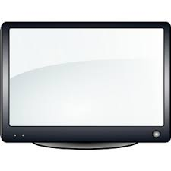
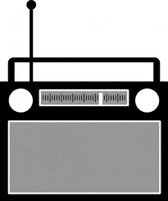
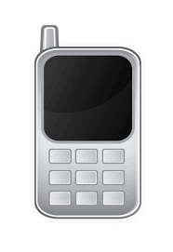
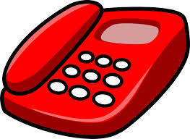
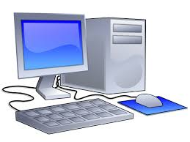
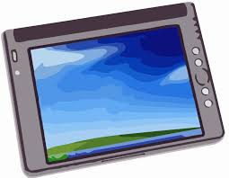
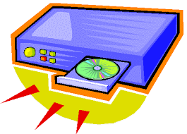
Information and technology use and literacy
Notes:
This slide is animated.
This slide may be omitted but is included to stimulate conversation around the importance of technology in our lives and homes.
It aims to gain an understanding of the role of technology in an individual’s life. It shows possible items of technology used for pleasure and pleasure and also to provide information.
In our example, let us assume that John has a mobile phone, and a wide screen TV. He also has a computer which he uses for accessing the Internet, but he doesn’t have a landline. This would make standard telecare solutions difficult (or expensive) to implement.

Slide 23
Social capital
Next of kin
Who is it?
Where do they live?
How easy to contact?
Sons and daughters
How many?
Where are they?
Grandchildren
Formal carers
Volunteers
Brothers and
sisters
Neighbours
Community or church groups
Cousins
Friends
Notes:
This slide is animated.
It considers how, and how often, an individual interacts with his or her family, friends and community groups. It demonstrates the questions that may be asked non-intrusively to extend the profile of the individual. Social capital and connections are more than knowing who the next of kin are, and where they live.

Slide 24
John’s connections - is he well connected?
Daughter
Son
Grandson
Granddaughter 1
Granddaughter 2
Sister
Nephew
Cousin
Neighbour 1
Neighbour 2
Friend 1
Friend 2
- visits every day and does some cleaning
- visits once a week, phones twice a week, brings a takeaway
- calls once a month with some meat
- rings twice a week asks what he needs
- emails once a month from college
- telephones every day
- sends text message once a week, rings once a fortnight
- calls once a month, rings every other week
- holds a key but never calls
- helps with the garden and bins
- takes him to the pub for lunch once a week
- calls for a chat every other week
Notes:
This slide is animated.
It fills in some of the blanks for John by showing who lies within his circle of friends and family. It would seem to show that he has more than a dozen connections.
It also gives details of how often each of John’s connections interacts with him whether by visiting, by phone or by e-mail.
The facilitator can ask the opinion of participants about this level of interaction, and whether it is likely that John is socially isolated or lonely. John isn’t socially isolated because he sees his daughter every day but may be lonely. Loneliness is more subjective. Many people believe that social isolation and loneliness issues are increasing and will ultimately lead to more people being depressed, having a lower quality of life, and being more likely to be taken ill.

Slide 25
Wants and needs
From the profile, it should be possible to work out what John wants
It suggests some of the issues that prevent him from being able to do what he wants
It’s possible to work out what he will accept and embrace – and what wont work because of his lifestyle
It doesn’t tell us necessarily what he needs
Will it make John more happy if we can address these “wants” using technology?
Notes:
This slide provides a link between the profile and what technology might help to improve his life.

Slide 26
What do we think John should be offered?
There aren’t any wrong answers – because the suggestions are not a prescription!
Think outside the box – look for what he wants
What about a subscription to a dating agency?
How can we give him control of his health?
What are the risks involved with these solutions?
What about the risks he faces without these solutions – not only to his safety but also to his independence and well-being?
Notes:
This slide is animated.
It invites participants to think innovatively in terms of what support may be needed for John bearing in mind that he wants a female friend so that he can go out more (one who liked trains would be a bonus!)
There are some risks to joining a dating agency – he could meet someone who is after him for his money, but going out drinking more often might upset his diabetes, especially if he is no longer so good at taking his medication.
A failure to recognise the issues that John has could lead to depression, and a general decline in his health and well-being. So there needs to be some thought given to balancing the technologies provided.
It allows an opportunity to emphasise that the technology should enable better outcomes to achieved (in line with new legislation).

Slide 27
Hazards and risks
Hazards are everywhere and increase the likelihood and/or the severity of accidents (i.e. the risk)
We must overcome them on a daily basis – this is an important aspect of independent living
If an individual has good sensory function, insight and experience, hazards and risk levels can usually be recognised and action taken to avoid an accident
A risk assessment needs to consider and allow for:
Sensory needs
Cognitive impairments
The Duty of Care of housing and of public sector organisations
Notes:
This slide is animated.
It builds on the idea that there are risks involved both in providing technology and in failing to provide technology. It is assumed that participants understand that risk is the product of the likelihood of an adverse event occurring (e.g. an accident) and the level of harm that can be done if such an event actually occurs.
This slide introduces the concept of hazards and how they are everywhere, and combine to determine the likelihood of accidents.
This leads to the idea that the risks may be greatest for people who either aren’t aware of hazards because they can’t hear or see them, or who don’t have the insight to appreciate risks as a result of cognitive impairment or intellectual disability.
The assessor must take these factors into account when performing a risk assessment including the responsibility of various bodies to manage or mitigate the risks through appropriate interventions.

Slide 28
Types of hazard
Environmental | Sensory | Health | Lifestyle | Weather
Damp | Poor eyesight | Chronic disease | Alcohol | Snow and ice
Stairs | Poor hearing | Cognitive impairment | Smoking | Heavy rain
Clutter | Poor heat detection | Polypharmacy | Recreational drugs | High temperature
Old cooking appliances | Poor sense of touch | Loss of strength | Lack of exercise | High humidity
Poor level of lighting | Poor sense of smell | Poor balance | Overeating | Cold
Notes:
This slide is animated. It will reveal a table showing different types of hazards.
There are many different types of hazard to consider…
It links particular conditions including the state of the home environment, health and weather to the hazards that might be at play in each case.

Slide 29
Linking hazards to risks
Smoking | Poor eyesight | Poor cognition | Diabetes
Lung cancer | Falls | Fire | Hypoglycaemia
Heart disease | Food poisoning | Becoming lost | Falls
Fire | Medication errors | Poor nutrition | Amputation
Loss of friends | Social exclusion | Loss of friends | Poor nutrition
What other risks are associated with each of these hazards?

Slide 30
Session 2: Risks, issues and adoption models

Slide 31
Assessing for risk
The risk associated with a potential accident/dangerous incident
=
The likelihood of the event occurring
(never, sometimes, often)
x
The degree of harm that occurs as a consequence
(none, minor injury, serious injury, death)
Notes:
This slide is animated.
It provides a definition and understanding of risk and how it is the product of the likelihood of an adverse incident such as an accident and the amount of harm that occurs as a result of the incident.
Both likelihood and degree of harm may be estimated using a three (or a five) point scale.
Using a three point scale, an event that may happen sometimes would be scored two while harm judged as a minor injury would also be scored as two. The risk would be four out of a possible 9 and would be regarded as moderate.

Slide 32
Colour-coded matrix showing levels of risk
 | Likelihood scores
 | Very unlikely | Unlikely | Possible | Very likely | Certain
Severity scores | 1 | 2 | 3 | 4 | 5
1 | 1 | 2 | 3 | 4 | 5
2 | 2 | 4 | 6 | 8 | 10
3 | 3 | 6 | 9 | 12 | 15
4 | 4 | 8 | 12 | 16 | 20
5 | 5 | 10 | 15 | 20 | 25
Notes:
This slide is animated and features a table that is hidden when first shown and which is slowly revealed to show a colour-coded matrix showing levels of risk.
In general, it is possible to express the likelihood of an accident or mishap occurring on a scale ranging from very unlikely through to highly likely, irrespective of whether the primary concern is for the well-being of an individual or the integrity of a building.
At the simplest level, it is possible to use only three different levels of likelihood – very unlikely, possible and highly likely which can be scored one, two or three respectively. However, in many practical cases there need to be more options. Five choices are often offered professionally; these can be scored from one to five.
In the same way, the harmful consequences of such an adverse incident can be expressed on a scale ranging from none through to severe. As each agency may define the level of harm in different ways, the tendency is to offer five options. The result is that the risk scores can be calculated between one and 25 rather than one to nine only when using three scores for likelihood and impact. This offers more opportunities to demonstrate risk reduction due to interventions such as telecare.
The slide shows a full matrix with colour coding. The facilitator may use this to lead a discussion on how different agencies may use different criteria for outcomes. For example, the NHS may see death as the worst outcome (i.e. a score of five) while an adult care organisation may score five a loss of independence leading to a residential care admission. A landlord may see the demolition of a property as a five.

Slide 33
Management of risk
Identify tasks
Identify hazards
Determine likelihood
Activities of daily living that aren’t performed by carers
Assessment tools and professional judgement
Professional judgement and actuarial values
Individual, carers, neighbours or property could be harmed
Assign likelihood and consequence values between 1 and 5 for each risk
Try to reduce either likelihood or consequences of highest risks
Consider harmful consequences
Record risks and actions taken
Manage risks
Calculate risk scores
Notes:
This slide is animated.
It shows seven steps to a risk assessment. Each step is illustrated by a procedure (though limited in scope):
Identify tasks associated with independent living
Identify hazards associated with performing these tasks
Determine likelihood of each hazard leading to adverse incident
Consider harmful consequences of each adverse incident
Calculate risk score for each adverse incident
Manage risk for risks with highest scores
Record the details of the risk and the actions taken to reduce them

Slide 34
Documenting risk management in social care and housing
Identified risk | Assessed risk score | Proposed technology solution | Risk score with technology
Falls at night | 20 | Bed occupancy sensor | 12
Flood due to taps left on | 16 | Flood detector | 12
Fire | 16 | Smoke detector, temperature extremes sensor | 9
Nocturnal wandering | 15 | Property exit alarm | 9
Medication mismanagement | 15 | Medication dispenser | 6
Gas explosion | 15 | Linked gas alarm | 10
Suffocation by CO | 10 | Linked CO alarm | 5
Notes:
This slide is animated.
It describes the risks identified for an individual who has a cognitive impairment and who lives alone. The risk scores are also shown and reveal that six of the seven risks are considered severe and need to be managed. Possible technology solutions are shown for each risk. Finally, the new risk scores are shown. These show that two of the risk are now considered to be low (green) while the other five are acceptable (amber).
34

Slide 35
Focus on issues (1)
Ill Health
Recovering from an accident
Returning home after surgery
Recuperating after infection, virus or disease
Frailty
Long-term conditions
Cancer
Neurological disease
Diabetes
Arthritis
Depression
Notes:
This slide is animated.
It shows particular aspects of a person’s health and well-being that can be considered to be hazardous which are then related to risks.

Slide 36
Focus on issues (2)
Disability
Physical
Cognitive
Sight and hearing
Speech and communication
Home environment
Stairs
Damp
Lack of heat
Dirty facilities
Notes:
This slide is animated.
It shows particular aspects of a person’s health and well-being that can be considered to be hazardous which are then related to risks.

Slide 37
Focus on issues (3) - obstacles
Family support
Nobody close enough to help
Wont ask them to help
Don’t trust them
Attitude to technology
Not technology literate
No equipment
No broadband
Don’t understand benefits
Notes:
This slide is animated.
It shows aspects of life that can be obstacles to finding appropriate solutions.

Slide 38
Frailty
Frailty isn’t an illness but a syndrome that combines the effects of natural ageing with the outcomes of potentially having a number of long-term conditions.
Shrinking
Low physical activity
Exhaustion
Frailty
Slowness
Strength
Medication Management
Doorstep Crime
Falls
Keeping Warm
Notes:
This slide is animated.
This slide focuses on Frailty as an example of a condition related to ill-health. It shows that this condition may be linked to a number of issues (in red at the bottom) that might need to be addressed.
Frailty isn’t an illness but a syndrome that combines the effects of natural ageing (including a decline in musculoskeletal, endocrine and immune systems) with the outcomes of potentially having a number of long term conditions.
If three out of the following five indicators are present then a person may be defined as being frail:
Shrinking – unintentional loss of 5 kg (12 pounds) of weight in a year
Exhaustion – lacking energy or showing signs of fatigue
Strength – loss of physical robustness
Slowness – a lethargic and unsteady gait
Low physical activity – sedentary behaviour

Slide 39
Some conditions and issues
Stroke | Low Vision | Diabetes
Speech deficit | Risk of falls | Risk of falls
Limited limb movement | Bogus callers | Poor nutrition
Reduced mobility | Cooking accidents | Lack of stamina
Incontinence | Social isolation | Foot care
Memory deficits | Hygiene issues | Lack of exercise
Notes:
This slide is animated.
It reveals a table of conditions with associated risks.
It may be excluded if participants don’t need examples of conditions leading to particular issues.
If included, it could be used to ask participants for examples before showing them the rest of the slide which has 5 issues listed for each condition.

Slide 40
Some conditions and issues (2)
Dementia | Learning disability | Frailty
Communication problems | Bogus callers | Risk of falls
Temporal orientation | Fire safety | Poor nutrition
Becoming lost | Social isolation | Reduced mobility
Poor sleep patterns | Seizures | Home safety
Fire safety | Hygiene | Low muscle strength
Notes:
This slide is animated.
It reveals a table of conditions with associated risks.
It may be excluded if participants don’t need examples of conditions leading to particular issues.
If included, it could be used to ask participants for examples before showing them the rest of the slide which has five issues listed for each condition.

Slide 41
Confirming profile information
The home environment (including furniture and appliances) can make technology solutions more personalised but difficult to provide.
It may be worthwhile having both the individual and/or their family or advocates sign off the profile before developing the risk assessment and the tailored solution.
Information provided during the assessment process may not always be wholly accurate:
Individuals may neglect to mention some activities
Family members and neighbours may exaggerate behaviour
Technology can be used to confirm/deny such behaviour:
Activity monitoring systems
Cameras that capture images and times of visitors
Notes:
This slide is animated.
It attempts to explain that the layout of furniture and the ownership of some appliances, such as gas cookers, make technology provision difficult, and the plan needs to be checked before attempting installation.
It also warns that people can be perverse in providing information if they believe that certain answers will help achieve an outcome which may not be in the best interests of the individual or of the sponsoring authority such as a council. Neighbours sometimes tell stories of dangerous incidents and of issues such as going out in the middle of the night in pouring rain dressed in night-clothes.
The slide suggests the introduction of technologies that can be used to monitor the home and its resident to confirm or deny any allegations.

Slide 42
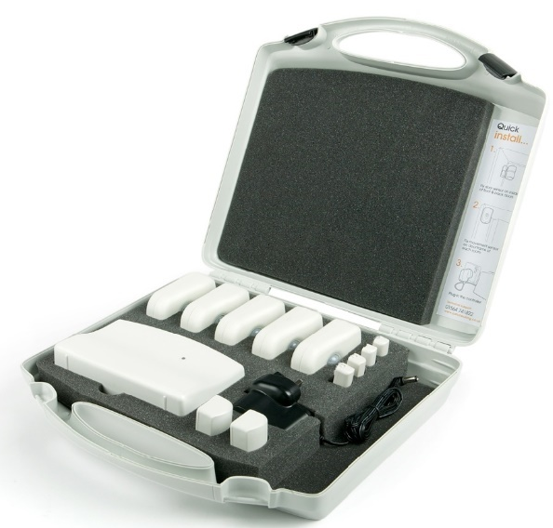
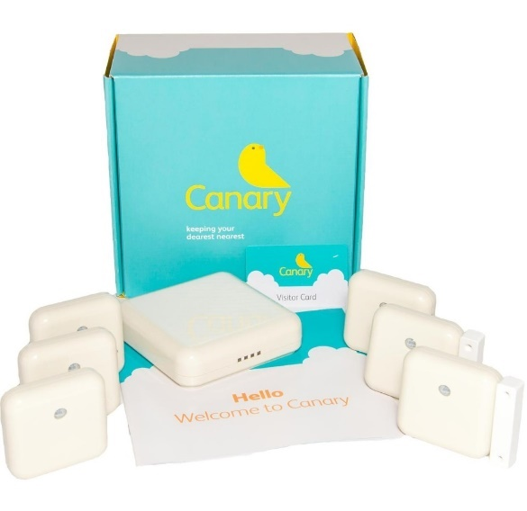
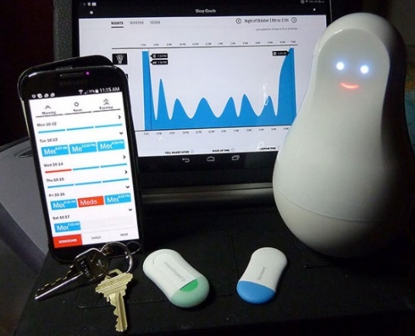
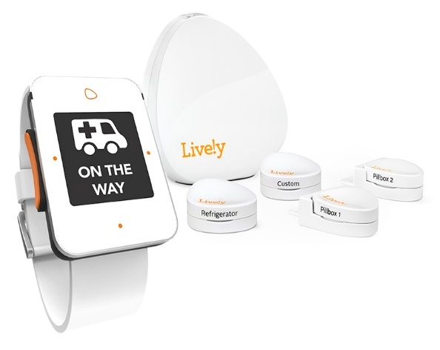
Activity monitoring systems
Systems such as Just Checking and Canary can be installed in minutes to enable room and door activities to be recorded and viewed remotely over the Internet.
Other systems use smaller sensors that can detect specific actions enabling alerts to be generated if routine tasks are not performed on time.
Notes:
This slide is animated.
It shows popular activity monitoring systems (Top part) based on movement in each room, and door status sensors.
The lower half of the slide shows newer systems that use small tags that are attached to items such as the fridge, the pill box, the bed or the microwave oven in order to detect specific activities.
The sensors all communicate wirelessly with a hub which sends the data to the internet where it can be viewed. Most use mobile phone technology.
If possible, the hardware should be available to display during the assessment presentation.

Slide 43
Monitoring activities
bed
television
front door
hall
chair
kettle
back door
lounge
cooker
lamp
fridge door
kitchen
telephone
microwave
medication
bathroom
water
radio
larder
bedroom
0
0
0
0
2
2
2
2
4
4
4
4
6
6
6
6
8
8
8
8
10
10
10
10
12
12
12
12
14
14
14
14
16
16
16
16
18
18
18
18
20
20
20
20
22
22
22
22
23
23
23
23
One day (24-hours)
One day (24-hours)
One day (24-hours)
One day (24-hours)
Notes:
This slide is animated.
It shows simulated data that can demonstrate how easy it is to view activities in such a way enables an assessor to understand an individual’s lifestyle. It consists of four different screens of data for the same 24-hour period. Generally, few systems would record so much information – so current systems record a much more limited data-set which needs fewer sensors and which is therefore much less intrusive.
In the future, the Internet of Things will allow much more data to be collected without having to install extra sensors.

Slide 44
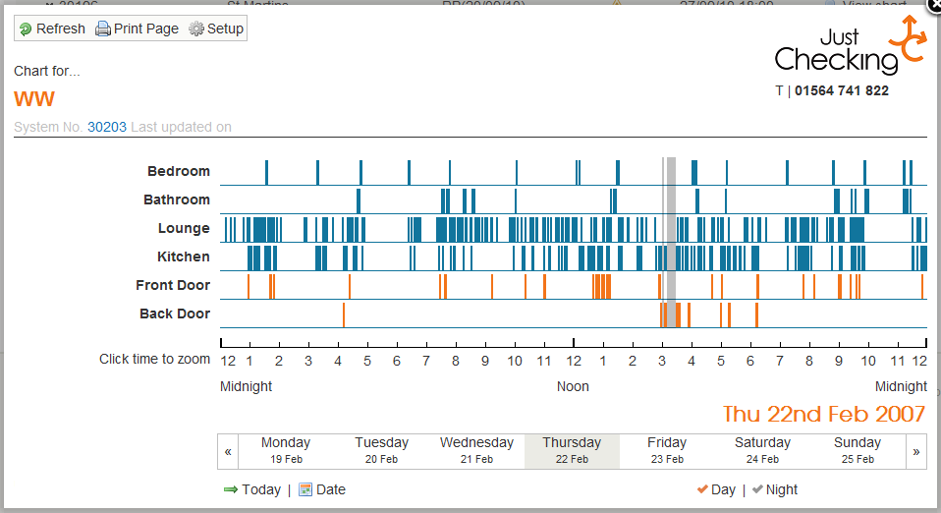
Case showing extremely agitated individual
Used with permission.
Notes:
This slide may be omitted if there is no need to show a practical example of this technology in use.
This slide shows a very active individual throughout the monitoring period – an agitated pattern of behaviour through the day and night may be observed with few gaps that might indicate rest. It transpired that medication was not being taken appropriately.

Slide 45
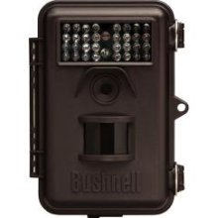
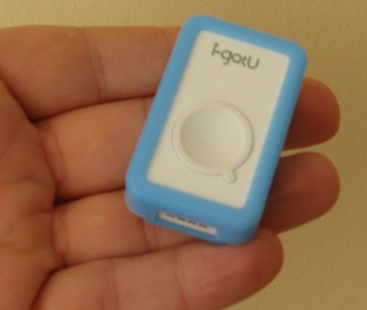
Technologies to help confirm or identify some issues
Camera technologies:
When does the individual go out and return?
Who else enters the property and how long do they stay?
GPS tracker devices:
Where do they go when they go out?
Do they cross dangerous roads and rivers?
© KD 2012
Notes:
This slide is animated.
It considers the role of a GPS tracker in recording two different routes taken by someone leaving home at night. One is dangerous and involves crossing a motorway!
The device shown is used by photographers to create a record of where pictures were taken but can also be used to record location at short time intervals to allow a crumb trail to be generated when downloaded to a computer.
The slide also introduces a role for cameras. Field cameras are motion activated and are used by nature lovers to record animal or bird activity in their garden at night. They could be used to record people entering and leaving a property. Each image is date and time-stamped.

Slide 46
Issues of ethics and choice… discuss!
Use Ethical Framework based on 4 principles:
Beneficence - involves balancing risk acceptance & aversion
Non-maleficence - finding a balance between avoiding harm and respecting decisions, dignity, integrity and preferences
Autonomy – empowering independence without causing social isolation, loneliness or depression
Justice - treating fairly and equally, and by respecting rights and preferences whether or not they are perverse
So …
Technology can be introduced (especially for assessment) if it is necessary to help achieve the overall ambition of an individual.
It might also be used to ensure that the user is not harmed by other technologies that are being used.
Beauchamp, et. al (2002)
Notes:
This slide is animated.
This slide may be used to stimulate debate (It could be printed out as a handout, if desired). The word-cloud shows some key topics of relevance.
Notes for discussion:
These monitoring technologies are useful BOTH to confirm risky behaviour or unmet needs, AND to confirm that there are no risky behaviours. All such devices can detect and record incidents that are personal (e.g. going to the toilet during the night) and of a more sensitive nature (e.g. a visitor being admitted).
GPS tracking devices have been described as tags – the same technology is being deployed to monitor the movements of criminals released from jail under licence.
Cameras are now small, ubiquitous and low-cost – they can provide remote high quality video footage of people: outside or entering a property, or moving about and performing tasks inside a property.
When given a choice, individuals may choose an aesthetically pleasing design rather than the best for functionality. It is important that the abilities and benefits of technology are not over-sold to people. It is important that they are not over-confident and undertake risky behaviour because they have a new piece of equipment or service. The limitations of any technological solution should be clearly explained.
A range of ethical issues must be considered and explored as part of discussions and assessment including:
Providing good quality, clear information about all options including not introducing Assistive Technology or Telecare
Consider benefits and any disadvantages or possible harm
Informed consent? Is the individual fully involved in the decision?
Concerns about monitoring – does this respect privacy & autonomy? Data security - where does it go? who has access?
Issues to do with intrusion and the use of prompts or notifications to try and ‘nudge’ user into better behaviour that will have a positive outcome on their wellbeing. Will users get fed up of constant ‘nagging’ by technology? Will they try and cheat the system into thinking that they are doing what they should be (e.g. paying the next door neighbour’s son to wear an activity monitoring device when they are taking the dog for a walk!)
Consider who benefits the most from the technology enabled care package? Is it the person or their carer? What are the issues to take into account here?
What about the design/look/feel of the products? Do they blend in or are they clearly a ‘badge of dependence’?
The second part of the slide provides some guidance in considering issues related to ethics by introducing an ethical framework based on Beauchamp et al, 2002). It goes on to offer simple conclusions that can help the assessor to proceed to prescribe technology solutions.

Slide 47
Exercise 2
Split into 3 teams. List the major issues associated with:
Team 1: Depression, and hearing loss
Team 2: Recuperation after illness, and a cold home
Team 3: Poverty, and anxiety
You have 10 minutes to produce your list.
There are no wrong answers.
Notes:
This slide is self-explanatory and should be left on the screen while the teams perform the exercise. The facilitator should allow the teams to talk through their lists, and should then look for issues that are common across all the teams.

Slide 48
Time for a break …

Slide 49
Session 3: Models of service provision
Notes:
Before the start of the second session, participants could be asked for any questions before moving on.

Slide 50
Different models of connected technology for care and support
Telecare alarm services have thrived over the past decade because they are ideally suited to a model of delivery that is built around a 24-hour monitoring centre.
This has become the hub for service development and delivery in Wales and elsewhere - but it does not suit the needs of everyone:
It has encouraged a “one-trick” approach to managing risk with emphasis on rapid detection and response to emergencies, rather than an integrated approach that also aims to prevent accidents and satisfy unmet needs
Not everyone lives alone and needs the level of standard intervention that alarm telecare services can provide
New technologies offer more personalised approaches
Notes:
This slide describes the limitations of the provision of technology solutions currently offered by service providers, including those in Wales.
It should be emphasised that everyone is different and should not therefore receive the same technology solutions.
There is a need for alternative approaches in order to produce personalised care options.

Slide 51
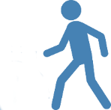
Models of technology enabled care
Person is housebound and lives alone; has no close family
Person lives with family carer who is with them at all times
Person lives with family carer who may be absent occasionally
Person is generally well. Does not want to involve external organisations.
Vulnerable person is not housebound but may be at risk
1
2
3
4
5
1 - 24/7 Call handling centre to notify family members if there is a problem
4 - Could use activity monitoring with alerts to carer’s phone in the event of a problem.
5 - Could use mobile care (mCare) with suitable apps; call handling centre optional
3 - Carer may be alerted through their mobile phone; call handling centre is optional backup
2 - Plesiocare – can use local alarm pager
Notes:
This slide is animated.
It shows five models of technology enabled care to show the different ways it can help…
Case 1 - Typically, the individual may be housebound and lives alone for all or most of the time. They may or may not have close family living locally who can attend in the event of a problem. They need a 24/7 monitoring service to alert remote family members or care/emergency services as required.
Case 2 – In this example, the individual either lives with a family carer or has personal assistants who are with them at all times. There is no need for a monitoring service, as there is always a responder present. This is called plesiocare.
Case 3 – This example shows someone who has close family support, perhaps they live with a family carer who may be away from home sometimes – perhaps at work. Any problems could be routed directly to the carer’s mobile phone in the first instance and only go to a monitoring service if the carer is unable to respond to the call.
Case 4 – This person is generally well, but would like a basic level of reassurance just in case; however, they are reluctant to involve external organisations. In this example, family members could use an activity monitoring service to monitor that everything is OK – and set up alerts that they would receive on their mobile phone or computer if there was a problem (e.g. if Mam hadn’t been to the kitchen to have a drink before 10am like she usually does).
Case 5 – This person is mobile and is able to go out alone for work, shopping or leisure. Perhaps it is a young adult with a learning disability who has recently got a new job. Ideally, they need an ‘always-available’ approach that supports them when they are at home and when out and about. Special apps for their smartphone could help them plan their day, find their way about and provide them with access to assistance if required.
Additional Background Information:
It is often apparent from the issues that individuals face that many of them relate directly to their risk of an accident or illness or are risks associated with lifestyle choices or their coping strategies. In each case, the risks needs to be managed either by reducing the likelihood of an adverse incident occurring or by reducing the impact of such an event. An effective means of supporting an improved outcome is through early detection and identification of an incident leading to an appropriate response.
This could mean a conventional telecare system based on fixed-line telephony linking a dispersed alarm unit in the home with a 24-hour monitoring centre. This corresponds to situation 1 and is ideally suited to someone who lives alone and rarely goes out unless accompanied. It is effectively the social alarm system which has provided support and reassurance for many mostly older people and their families for over 30 years.
Social alarm systems have evolved into telecare services by the addition of smart sensors and the adoption of personalised response protocols. They continue to provide important support to individuals and peace of mind to relatives. However, their essentially analogue nature means that they are not ideally suited to embracing advances in mobile and information technology. Furthermore, their requirement for a link to a 24-hour monitoring centre may be seen as an unnecessary intrusion by some. In particular, when a person lives with their family carer, who will inevitably respond to any emergencies detected by a sensor in the home, the role of a monitoring centre changes. This is the 2nd situation described and represents an application for “plesiocare” rather than telecare because the support is provided close by rather than at a distance. The sensors that may be relevant are similar to those used in situation 1, but need no longer connect to a dispersed alarm system but to a local alert notification system, such as a pager. This approach often results in a lower cost option, both in terms of the upfront cost of the equipment and on-going monitoring costs; however, their limitation is a lack of historical information on the nature and frequency of the alarms generated, which may offer an important insight in terms of preventing further problems.
In the same way, when the family carer goes out to work or to go shopping, leaving their older parent at home, to go to work or go shopping, they can be notified directly by programming the dispersed alarm unit to ring them or send them a message rather than using a monitoring centre. This is the 3rd situation shown and would generally use the same type of equipment in the home as in the 1st situation described above.
When the family lives some distance away from their loved one, they may choose to perform passive monitoring directly using internet-enabled services. These generally monitor movement and activity and employ exception rules that are set up specifically for that person. For example, a failure to enter the bathroom or kitchen during certain hours each day may indicate an alert, as might no use being made of the kettle, the microwave oven or the refrigerator. This type of need is described by the fourth situation and may be enhanced through the use of video interactions.
Finally, the vast majority of older people, whether they live alone or with friends or relatives, will spend time outside the home. It is recognised that the outdoors, exercise and opportunities for meeting with people will support well-being through relief of social isolation, as well as improvements in both physical and mental health. The concern that they may suffer an accident or illness may be managed by the use of a new range of mobile care devices that may be carried with them at all times, as well as linked sensors that may be worn and specialist apps that provide interaction and support. These mobile care (or mCare) applications can detect a range of problem situations including falls, periods of inactivity, convulsive seizures and becoming lost.
This 5th care situation shown is likely to become increasingly important as the population embrace the benefits of smartphones and mobile technology. This model of care could rapidly become dominant and provide attractive alternatives for all the scenarios in the slide, especially as access to the internet becomes ubiquitous and as telecare monitoring centres begin to support these services. In the meantime, it will be essential for assessors to consider which support scenario is most suitable for the individual.
It should be noted that all 5 scenarios relate to people living alone or with their carer. It may be apparent that many older people live as co-caring couples. Both may need monitoring so alarm systems may be relevant. However, current telecare systems don’t allow the activities of 2 or more people living together to be differentiated from each other, and this is a limitation. The exception is personal devices such as worn alarms. Indeed, one of the biggest advantages of wearable devices is that they provide information at an individual level. It must be assumed that future systems, and especially those that employ mCare, will allow for more person-centred approaches.

Slide 52
Mobile healthcare and apps
Notes:
This slide is animated.
It is optional if participants haven’t appreciated the scope and scale of apps for mobile healthcare.

Slide 53
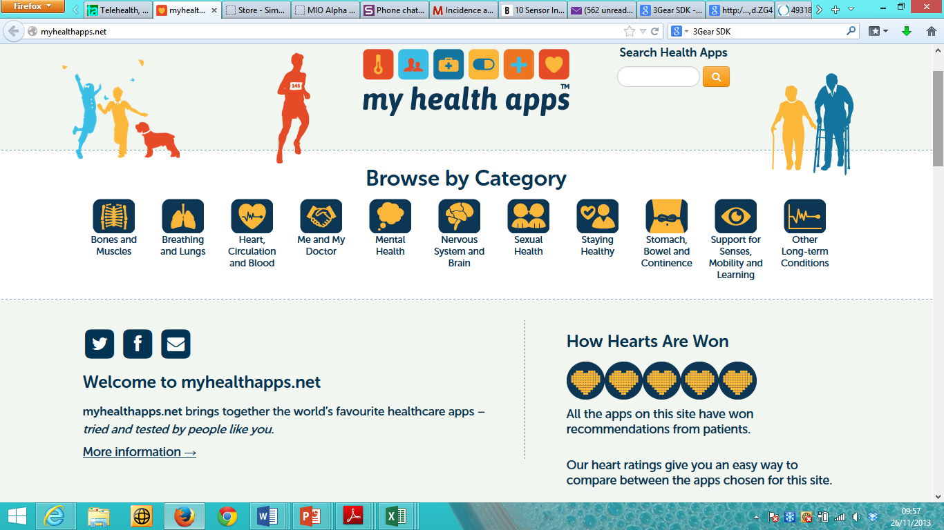
Finding apps for care and support
Notes:
This slide may be excluded.
It shows a resource for finding apps that are more specific than general health apps – though not necessarily relevant to social care. In practice, these apps are ideal for helping people to self manage their conditions.

Slide 54
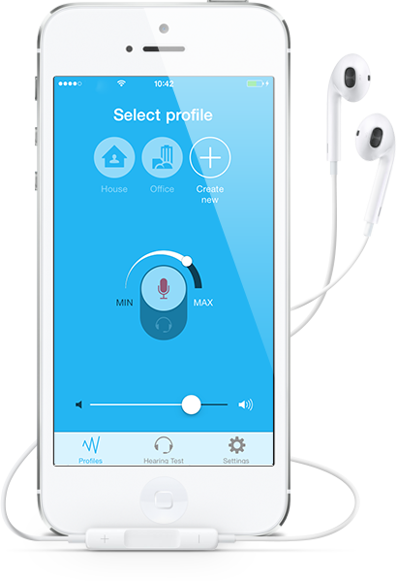
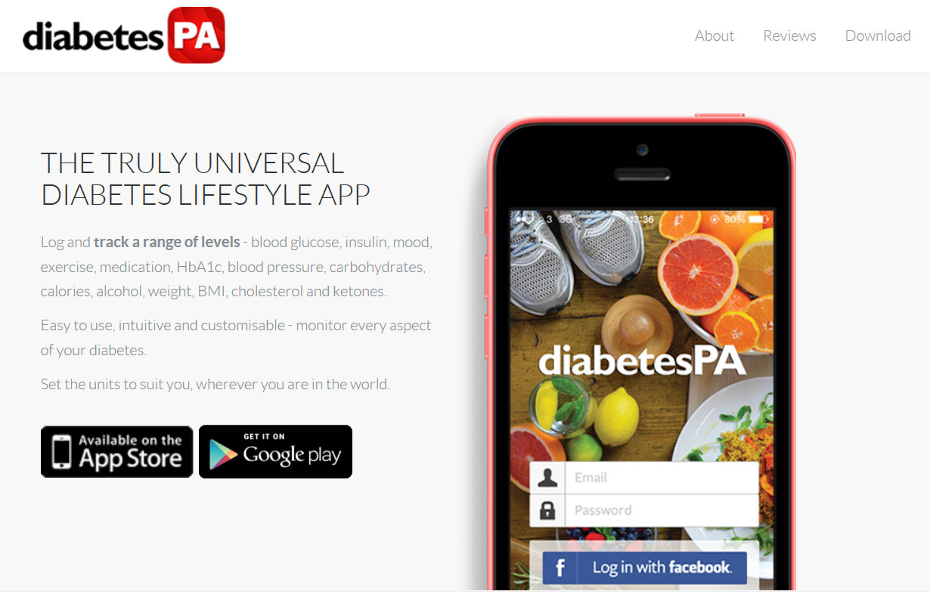
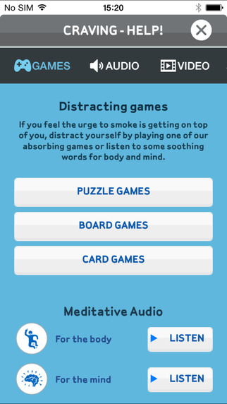
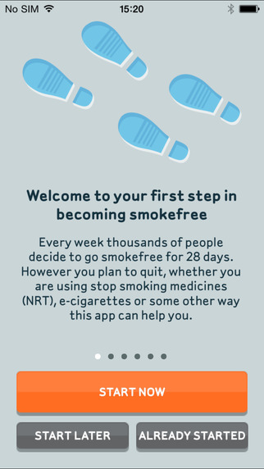
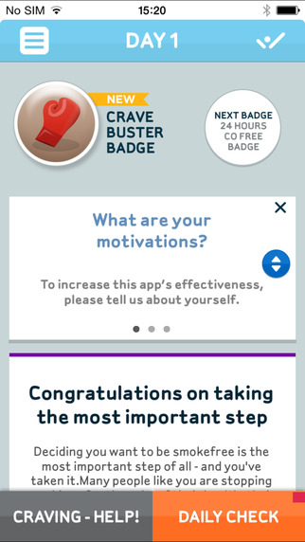
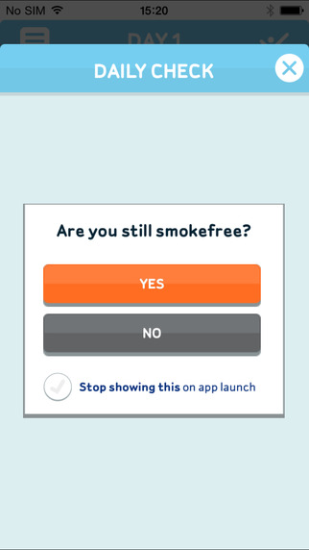
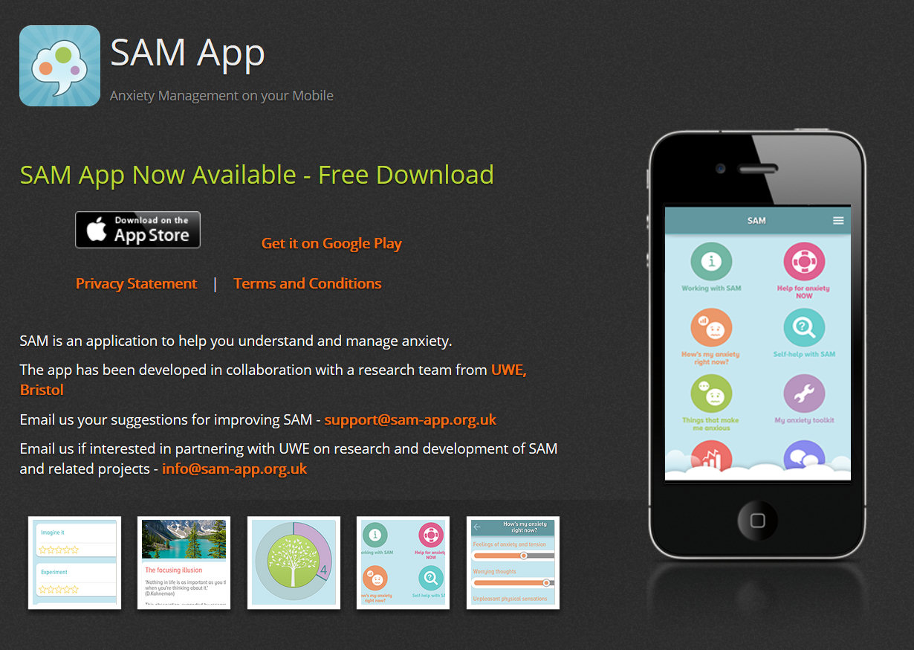
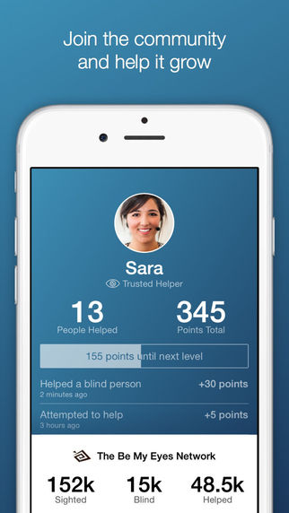
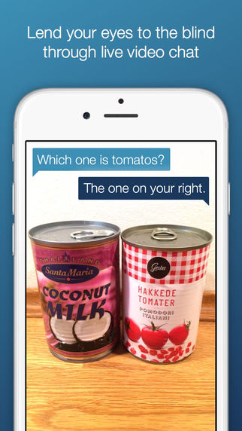
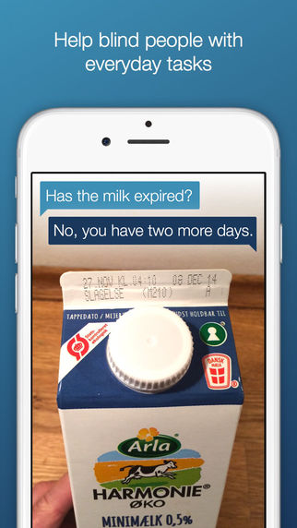
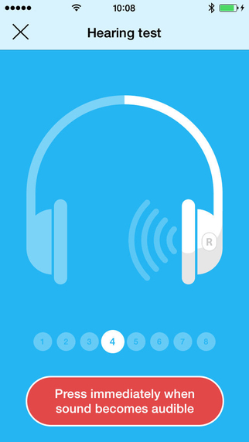
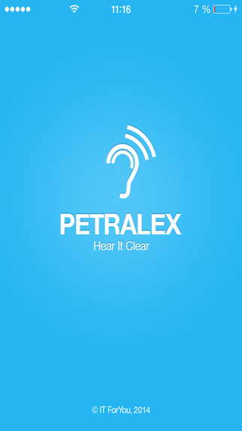
Health and well-being apps
Notes:
This slide is animated.
It shows examples of apps – diabetes tracking, anxiety measurement, mood, smoking cessation, hearing aid/test and a community-powered assistance app for people who are blind/have a visual impairment.
Find out more at the following websites:
http://www.diabetespa.com/
http://sam-app.org.uk/
http://www.nhs.uk/Tools/Pages/iphonesmoking.aspx
http://petralex.pro/
http://www.bemyeyes.org/
It should be mentioned that all smart phones are not the same and that some apps will run only on particular smart phones. Although many apps are free, some will need to be paid for.

Slide 55
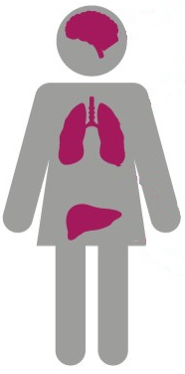
Causes of chronic disease
Poor diet
Stroke
Lack of exercise
Toxins
Heart disease
About 7,500 people in Wales suffer a stroke every year – that’s one every three and a half minutes or so.
Over 4,000 people in Wales die of coronary heart disease (CHD) each year. Over 3,000 people suffer a heart attack every year.
Chronic Disease Epidemic
Long-term stress
Smoking, Drinking & Drugs
Respiratory diseases
Diabetes
These are responsible for nearly 1 in 5 deaths in Wales.
177,000 people in Wales live with diabetes, and a further 70,000 people have diabetes but are either unaware or have no confirmed diagnosis.
Effects of poverty
Lack of fresh air
Ageing population
Notes:
This slide is animated.
It shows the prevalence in Wales of four major chronic diseases that can be monitored using vital signs technology.
It then shows eight possible causes of an epidemic in chronic disease emphasising smoking as a major contributory factor.

Slide 56
Technology and chronic disease
Telecare solutions address accidents & incidents. Rapid detection & identification lead to success. The situation is complicated with health issues…
Feature | Acute Disease | Chronic Disease
Example | Urinary Tract Infection | Arthritis
Onset | Abrupt | Usually gradual
Cause | Single | Multiple over time
Outcome | Usually curable | Incurable
Duration | Limited (a few days) | Lengthy & indefinite
Medication success | Usually effective | Indecisive with possible adverse effects
Notes:
This slide is animated.
It aims to explain the main differences between telecare and telehealth.
It then compares Acute Disease with Chronic Disease to illustrate the fact that chronic disease isn’t about detecting an emergency but requires a long term strategy that includes monitoring and review (leading to the next slide).

Slide 57
How telehealth works
Aim is to help patients to understand and manage their own conditions
This requires monitoring of some vital signs and a knowledge of symptoms (e.g. sleep quality)
Telehealth allows patients to measure their own vital signs each day and to answer some questions
Information can be automatically analysed to identify problems that need attention
This may be particularly relevant to people who have chronic cardiac or breathing issues
Notes:
This slide is animated.
It describes the purpose and mechanics of a telehealth intervention.

Slide 58
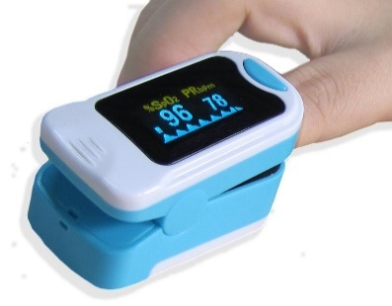
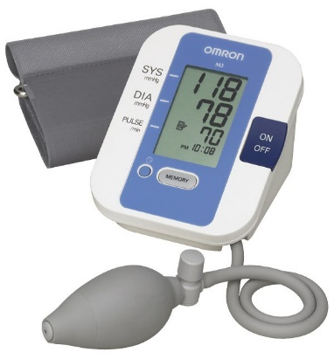
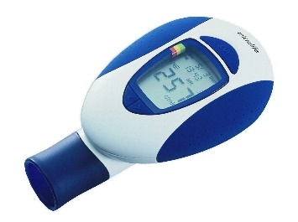
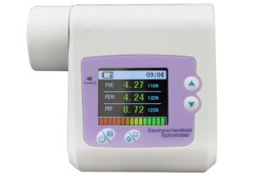
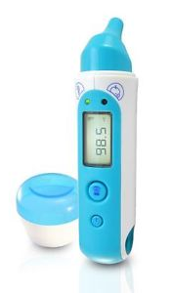
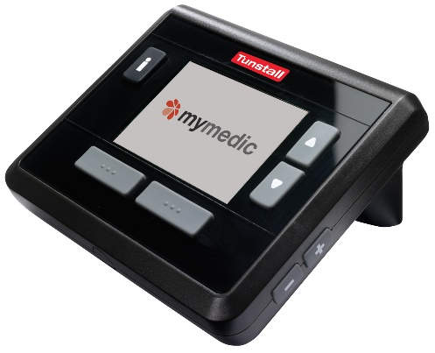
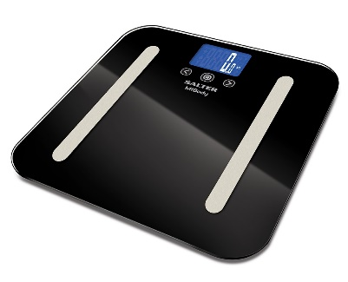
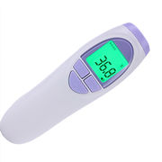
Telehealth peripherals
Pulse oximeter
Sphygmomanometer
Spirometer (or peak-flow meter)
Weighing scales
ECG monitor
Thermometer
Notes:
This slide is animated.
It describes some of the more popular peripheral telehealth sensors. They are normally connected to a hub either by a wire or, increasingly, using a Bluetooth wireless link.
A device such as a pulse oximeter (that measures the pulse rate and the level of oxygen saturated into the blood) can be connected directly to a hub that uploads data to a website, or it could be used to allow the wearer to respond to a text message request to send a reading by SMS. This would be an example of Simple Telehealth.
In this case, these devices can be used by individuals as part of their own self-care regime. Many can be purchased privately – some pulse oximeters, electronic blood pressure gauges and thermometers can be bought by members of the public for under £20 each either from the chemist or from on-line stores.

Slide 59
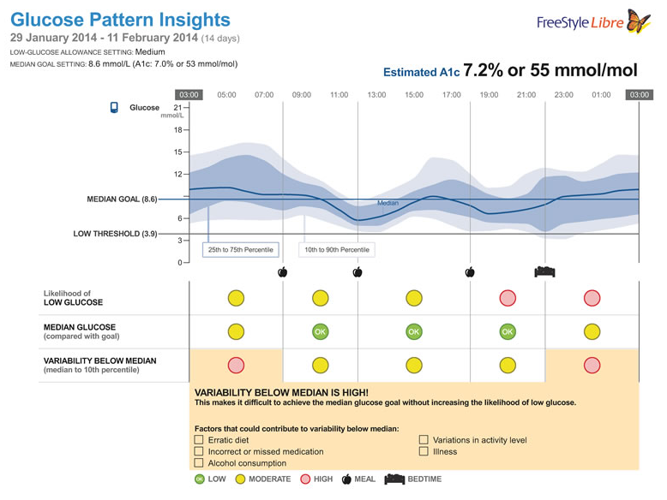
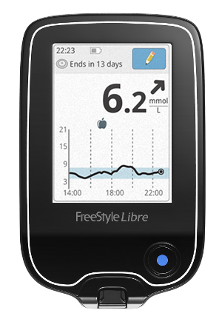
Non-invasive blood glucose measurement
Abbott’s FreeStyle Libre Flash Glucose Monitoring System has a sensor that’s attached to the back of the upper arm and a device that copies & displays the readings from the sensor.
The sensor records blood glucose levels every minute, sampling the interstitial fluid using a 5mm long filament that penetrates the skin.
Notes:
This slide is animated.
Diabetes is one of the most expensive chronic conditions that affects people in Wales. When poorly managed, it can lead to blindness and amputations as well as other disabilities that impact quality of life. Taking measurements of blood glucose currently involves pricking the finger – something that many people don’t like, especially if it has to be done several times a day. There are new approaches that will make the old technique redundant. This one involves a sensor attached to the arm and works continuously for several days.
It should be emphasised that these new devices, though approved for use in Europe, may not necessarily be available through the NHS for many years.

Slide 60
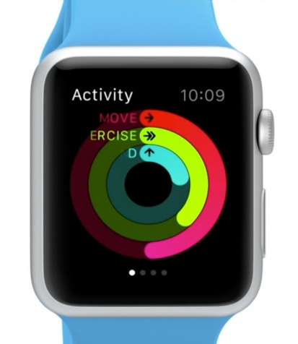
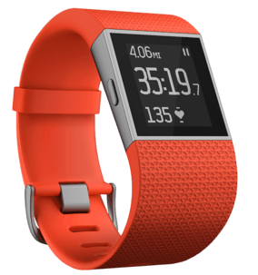
Future collection of health data
Notes:
This slide is animated.
In the future, the technology will be far easier to use and, thanks to mobile phone and internet technology, will be able to take measurements at any time, whether the individual is at home or out and about.
The slide shows eight different ways that this is already possible:
Apple watch
Fitbit Surge
This is a sheet from South Korea that records vital signs while the person is in bed
A smart vest with built in sensors and electrodes
An electronic sticking plaster
A sensor chip built into medication.
A “magic mirror” that uses camera technology to look at how the flow of blood through the body changes its colour, enabling the pulse rate to be calculated.
Finally, there is the Scanadu Scout, a device which can be pressed against the forehead at any time to measure a range of vital signs.
Wearable devices are becoming important for overcoming the problem of placing sensors close to the part of the body most relevant to measuring a physiological parameter.

Slide 61
Temporary tattoos measures vital signs
Wearable sensors measure temperature, hydration and skin strain for 2 weeks
Flexible electronics provide power and wireless connectivity
Notes:
In the future, for continuous measurement and recording of medical data, people may used body piercings or tattoos to make their devices “cool” and less stigmatizing.

Slide 62
Simple telecare alarm service
User group
Smoker
Tele-
comms
Fixed line
Database
Local database
Escalation, response, interaction
Location
Family
Own home
Service platform
Telecare dispersed alarm unit
Sensors and inputs
Smoke and flood detectors
Call handler
Telecare monitoring centre
Purchase cost of equipment ~ £250
Monthly service charge ~ £10 - £20
Notes:
This slide is animated.
It takes a generic view of a telecare service and makes it specific to someone who is at home and in receipt of a standard service involving the use of sensors around the home consistent with the needs of a smoker. It uses a fixed telephone line and a 24-hour monitoring centre which calls the family to respond. Note that the cost of the equipment is about £250 while there is a monthly charge (which covers maintenance and monitoring) that ranges from about £10 up to about £20 across Wales.
(Use the local figure if this is available).

Slide 63
Smartwatch epilepsy monitor
Notes:
This slide may be excluded.
It describes a smart watch system that detects convulsive epileptic seizures and communicates with an Android smartphone through Bluetooth and an app. This sends information via a web portal, and issues alert messages (SMS or email) to named recipients (family members) informing them where the user is. The limiting factors are mobile phone coverage and the length of time that the watch and the smartphone can be operated before they need to be recharged.
Extra information:
The SmartWatch is an epilepsy alarm built into a metal wrist-watch. It automatically raises an alarm if its built-in accelerometer detects repetitive shaking movements that are characteristic of an epileptic seizure. The end-user is also able to manually raise an alarm by depressing one of the buttons on the side of the watch. In order to communicate with a suitable responder, the watch must be linked to a suitable Android smartphone (using a wireless Bluetooth connection). An app accompanies the watch which allows the end-user or a carer to setup the device (e.g. to adjust the sensitivity of the seizure detection) as well as to setup contacts and how such contacts should be contacted in the event of an alarm condition (SMS text message and/or voice-call). The app will transmit the reason for the alarm as well as the location co-ordinates of the device. This can be used to lookup the location of the user on a mapping application or website. The app also allows medication reminders to be setup using the phone.
All alarm events are logged in the smartphone app and can be viewed by clinicians to give them a better view of the frequency of seizures. N.B. the device is triggered by the repetitive shaking motion of a tonic clonic seizure and hence isn't suitable for other types of seizure such as absence or Petit Mal events.
The unit can be purchased as a 'stand-alone' item to be used with an existing compatible phone or as part of a package that includes a Samsung Smartphone. In addition, it is necessary to subcribe to one of two levels of on-going service charge, which provide different features, explained below.
A 'Careline' Monitoring Service can be added to the subscription which places alarm calls to a 24/7 call handling centre and will respond to activations from the SmartWatch. The monitoring service can respond to voice and text alert messages, along with establishing the location of the device should they need to summon assistance to a SmartWatch user.

Slide 64
Simple telecare alarm service
User group
Person with epilepsy
Tele-
comms
Smart-phone
Database
Cloud database
Escalation, response, interaction
Location
Family
Anywhere
Service platform
Smart-watch
Sensors and inputs
Acceler-ometer and GPS
Call handler
Telecare monitoring centre
Purchase cost of equipment ~ £390
Monthly service charge ~ £24
Notes:
This slide is animated.
This shows the generic service solution modified to deal with the epilepsy smart watch arrangement described previously.
There is no longer a need for a monitoring centre as all data is stored on a bespoke database in the cloud.
Significantly, both the cost of the equipment and of the service charge are higher than for the traditional telecare services.
These prices will fall, but currently would add significantly to the overall cost if both traditional and new solutions were required to operate side by side.

Slide 65
Full class exercise
Which of the five models of support using technology and described previously would suit the following cases:
Pauline suffered a stroke last year at the age of 63 and can no longer walk without help. Her husband, George, retired so that he can be with her and take her out in his adapted car.
Joyce is 84 years old and has poor vision. Her main carer is Gill, who works as a receptionist at the medical centre. Joyce only goes out if Gill takes her.
Andrew is 14 years old and has convulsive epileptic seizures and an autistic spectrum disorder. He lives with his parents and sister, and enjoys school, especially using computers.
Elsie is a 90 year old spinster who lives alone in a sheltered housing scheme in Swansea.
Notes:
The first example is one where a couple is always together. They do not need external help but George would benefit from a plesiocare system which might, for example, alert him if his wife tries to get out of bed without help.
The second example involves a vulnerable person who is housebound except when her daughter takes her out. She could use a telecare system which sends alerts directly to her daughter who can respond whether she is at work or in the house. They need model 2 (shown again in next slide) but may wish to involve a monitoring centre if they want a back-up.
The third example could be managed at home with plesiocare and at school with an m-care system.
Finally, Elsie needs a remote 24-hour monitoring centre.
The facilitator may wish to ask participants if anyone has a parent who lives far away from them, and how they might like to check that they are ok.

Slide 66
Models of Technology Enabled Care
1
2
3
4
5
Person is housebound and lives alone; has no close family
Person lives with family carer who is with them at all times
Person lives with family carer who may be absent occasionally
Person is generally well. Does not want to involve external organisations.
Vulnerable person is not housebound but may be at risk
24/7 Call handling centre to notify family members if there is a problem
Plesiocare – Use local alarm pager
Carer may be alerted through their mobile phone; call handling centre as backup is optional
Could use activity monitoring with alerts sent through to carer’s mobile phone in the event of a problem.
Could use mobile care (mCare) system using smartphone and apps; call handling centre optional
Notes:
This slide is repeated here for convenience – the animation has been removed.
In this slide, five models of technology enabled care are illustrated to show the different ways it can help…
Case 1 - Typically, the individual may be housebound and lives alone for most all or most of the time; They may or may not have close family living locally who can attend in the event of a problem. They need a 24/7 monitoring service to alert remote family members or care/emergency services as required.
Case 2 – In this example, the individual either lives with a family carer or has personal assistants who are with them at all times. There is no need for a monitoring service, as there is always a responder present. This is called plesiocare.
Case 3 – This example shows someone who has close family support, perhaps they live with a family carer who may be away from home sometimes – perhaps at work. Any problems could be routed directly to the carer’s mobile phone in the first instance and only go to a monitoring service if the carer is unable to respond to the call.
Case 4 – This person is generally well, but would like a basic level of reassurance just in case; however, they are reluctant to involve external organisations. In this example, family members could use an activity monitoring service to monitor that everything is OK – and set up alerts that they would receive on their mobile phone or computer if there was a problem (e.g. if Mam hadn’t been to the kitchen to have a drink before 10am like she usually does).
Case 5 – This person is mobile and is able to go out alone for work, shopping or leisure. Perhaps it is a young adult with a learning disability who has recently got a new job. Ideally, they need an ‘always-available’ approach that supports them when they are at home and when out and about. Special apps for their smartphone could help them plan their day, find their way about and provide them with access to assistance if required.
Additional Background Information:
It is often apparent from the issues that individuals face that many of them relate directly to their risk of an accident or illness or are risks associated with lifestyle choices or their coping strategies. In each case, the risks needs to be managed either by reducing the likelihood of an adverse incident occurring or by reducing the impact of such an event. An effective means of supporting an improved outcome is through early detection and identification of an incident leading to an appropriate response.
This could mean a conventional telecare system based on fixed-line telephony linking a dispersed alarm unit in the home with a 24-hour monitoring centre. This corresponds to situation 1 and is ideally suited to someone who lives alone and rarely goes out unless accompanied. It is effectively the social alarm system which has provided support and reassurance for many mostly older people and their families for over 30 years.
Social alarm systems have evolved into telecare services by the addition of smart sensors and the adoption of personalised response protocols. They continue to provide important support to individuals and peace of mind to relatives. However, their essentially analogue nature means that they are not ideally suited to embracing advances in mobile and information technology. Furthermore, their requirement for a link to a 24-hour monitoring centre may be seen as an unnecessary intrusion by some. In particular, when a person lives with their family carer, who will inevitably respond to any emergencies detected by a sensor in the home, the role of a monitoring centre changes. This is the 2nd situation described and represents an application for “plesiocare” rather than telecare because the support is provided close by rather than at a distance. The sensors that may be relevant are similar to those used in situation 1, but need no longer connect to a dispersed alarm system but to a local alert notification system, such as a pager. This approach often results in a lower cost option, both in terms of the upfront cost of the equipment and on-going monitoring costs; however, their limitation is a lack of historical information on the nature and frequency of the alarms generated, which may offer an important insight in terms of preventing further problems.
In the same way, when the family carer goes out to work or to go shopping, leaving their older parent at home, to go to work or go shopping, they can be notified directly by programming the dispersed alarm unit to ring them or send them a message rather than using a monitoring centre. This is the 3rd situation shown and would generally use the same type of equipment in the home as in the 1st situation described above.
When the family lives some distance away from their loved one, they may choose to perform passive monitoring directly using internet-enabled services. These generally monitor movement and activity and employ exception rules that are set up specifically for that person. For example, a failure to enter the bathroom or kitchen during certain hours each day may indicate an alert, as might no use being made of the kettle, the microwave oven or the refrigerator. This type of need is described by the fouth situation and may be enhanced through the use of video interactions.
Finally, the vast majority of older people, whether they live alone or with friends or relatives, will spend time outside the home. It is recognised that the outdoors, exercise and opportunities for meeting with people will support well-being through relief of social isolation, as well as improvements in both physical and mental health. The concern that they may suffer an accident or illness may be managed by the use of a new range of mobile care devices that may be carried with them at all times, as well as linked sensors that may be worn and specialist apps that provide interaction and support. These mobile care (or mCare) applications can detect a range of problem situations including falls, periods of inactivity, convulsive seizures and becoming lost.
This 5th care situation shown is likely to become increasingly important as the population embrace the benefits of smartphones and mobile technology. This model of care could rapidly become dominant and provide attractive alternatives for all the scenarios in the slide, especially as access to the internet becomes ubiquitous and as telecare monitoring centres begin to support these services. In the meantime, it will be essential for assessors to consider which support scenario is most suitable for the individual.
It should be noted that all 5 scenarios relate to people living alone or with their carer. It may be apparent that many older people live as co-caring couples. Both may need monitoring so alarm systems may be relevant. However, current telecare systems don’t allow the activities of 2 or more people living together to be differentiated from each other, and this is a limitation. The exception is personal devices such as worn alarms. Indeed, one of the biggest advantages of wearable devices is that they provide information at an individual level. It must be assumed that future systems, and especially those that employ mCare, will allow for more person-centred approaches.

Slide 67
A brief overview of Vivo
falls
Notes:
This slide is animated.
Here is an example resource. It shows the home page of the Vivo guide and its purpose.
Vivo helps people to find products by linking conditions to possible issues and then finding products that address these issues. It results in a wider range of product options that individuals can then apply different filters to (such as price, manufacturer, etc.)
Vivo is designed to be at the right level for members of the public to use with ease.
Vivo Pro will provide additional information that will be of relevance to health, social care and housing professionals and will help them to compare and recommend products.
www.vivoguide.co.uk

Slide 68
Examples of matching goals to technology opportunities (1)
Goal | Examples of need | Technology options
Stay put | Avoid need for residential care | Telecare services
 | Move into level access home | Stair-lift or exoskeleton
Get out more | Visiting local amenities and friends | Mobility scooter
 | Attending social events | Go online to discover events
Be more independent | Perform domestic tasks without help | Buy a robotic cleaner
 | Take charge of making decisions | Online banking/shopping
Notes:
The following four slides show numerous examples of user goals, together with their needs, and possible explanations. It may be pointed out that few of these technology options would necessarily be offered by a funding body (such as the NHS, a local authority of a housing association) but all are available for private payers or through some third sector organisations.
The technologies may be unfamiliar as far as telecare services are concerned, but are generally available as retail offerings.
The facilitator may choose any number of examples to discuss from those listed.

Slide 69
Examples of matching goals to technology opportunities (2)
Goal | Examples of need | Technology options
Become physically fitter | Take more exercise | Use a treadmill
 | Lose weight | Wear a fitness tracker
Take up a new interest | Learn a new language | App/Web service
 | Play strategy games | Virtual games forums
See more of my family | Share birthdays and holidays | Video calls (e.g. Skype)
 | Follow grand-children | Social media (Facebook)

Slide 70
Examples of matching goals to technology opportunities (3)
Goal | Examples of need | Technology options
Improve Quality of Life | Learn relaxation techniques | Virtual yoga or meditation
 | Enjoy films and music | Reminiscence
Feel less anxious | Feel safe at home | Telecare sensors, home security products
 | Feel more secure | Video door-bell
Improve well-being | Improve stamina | Wii/Kinect video games
 | Overcome pain | TENS machines

Slide 71
Examples of matching goals to technology opportunities (4)
Goal | Examples of need | Technology options
Become a good cook | Take a course in cookery | Electronic cook-book
 | Invite friends for dinner | Virtual dinner party
Enjoy better sleep | Sleep for longer | Monitoring of sleep quality
 | Wake up refreshed | Provide relaxing music

Slide 72
Falls management programme
Population falls analysis
Profiling and assessing people
Picking up and helping fallers
Predicting likelihood of a fall
Panic alarms and detection systems
Prevention interventions
Notes:
This slide is animated.
By way of an example, let us consider the problem of falls. This slide shows a six point approach to managing falls with a specific role for technology after an appropriate profiling and assessment has been offered.

Slide 73
Some assessment considerations (1)
Ask Questions…
Do they get up during the night (how often and for how long)?
Do they switch the lights on (bedroom, landing, bathroom)?
Attitude to wearing devices (hearing aids, spectacles, pendants)?
Which side of the bed they use and get out of (left, right)?
Notes:
This and the following two slides introduces specific additional questions, observations and tests that can be included in an assessment aimed at supporting people who are at risk of falling.

Slide 74
Some assessment considerations (2)
Observe Actions…
The type of bed that they sleep in (double, single, divan, electronic)
Their posture and strength (erect, slumped, frail, robust)
Their use of walking aids (stick, frame, correctly, for decoration)
The bathroom (bath or shower, grab-rails, steps, other aids)

Slide 75
Some assessment considerations (3)
Test Mobility…
Speed of walking (and ability to get up from and sit down on a chair)
Their gait (limp, slow, fast, shuffle)
Their balance (surfing, use of stick or crutch, grab rails)

Slide 76
Opportunities to reduce likelihood of falls
Assistive mobility devices
Walking sticks
Zimmer frames and trolleys
Grab rails and banisters
Stair devices
Stair lift
Stairsteady
Quadstep
Bathroom aids
Raised seat
Perching stool
Notes:
This slide is animated.
People will be familiar with mobility devices and with stair lifts but may not have seen the Stairsteady which is an entirely mechanical device suitable for straight stairs, nor with the Quadstep which helps people who use a walking stick to be more stable getting up or down stairs.

Slide 77
Opportunities to reduce likelihood of falls
Improve sight
Better lighting
Contrasting edges
Medication support
Reminders
Dispensing aids
Rush prevention
Cordless phone
Door opener/intercom
Notes:
This slide is animated.
It describes three ways of reducing the likelihood of falls.
Examples are given for each. Cordless phones can be carried when they move from room to room, so that they don’t have to rush to a phone when it rings. It also remove the use of trailing wires that can trip people up. Intercoms are rapidly becoming video enabled.

Slide 78
Opportunities to reduce likelihood of falls
Other reminders – “don’t forget”:
To put on slippers or
To wear your specs
To use your walking aids
To eat well (fridge)
To keep hydrated (water use)
Exercise aids:
Vibration platform
Treadmill or exercise bike
Activity monitor or pedometer
Furniture:
Motorised chair
Profiling bed
Notes:
This slide is animated.
It lists a number of different approaches to reminding people to take care of themselves. Electronic profiling beds and chairs (Lazyboy for example) help people to get to their feet without help.

Slide 79
Opportunities to reduce the harm from falls
Lessening the impact:
Hip protectors
Cushion flooring/carpet
Fall mats
Fall detection:
Panic alarms
Worn devices
Inactivity
Bed occupancy monitor
Camera devices
Sound/vibration detectors
Floor methods
Notes:
This slide is animated.
The harm caused by a fall can be reduced by cushioning the impact either by wearing hip protectors or by having soft mats and carpets to land on. Hip protector knickers are unpopular – but are constructed in the same way as motorbike shorts!
Fall mats are popular in the USA and are being used increasingly in this country since cot sides were withdrawn in many nursing homes because of the potential for patients to be trapped or strangled in them. Fall mats, can be a trip hazard, so their general use is restricted.
The psychological harm resulting from a fall can be reduced if the individual knows that they will not have to endure a long lie waiting for help. This can be ensured by the use of fall detectors or alarms. Pendants are the most common solution but they have little value if people don’t carry them at all times, and especially not at night. The same is true for worn fall detectors – which is why there is so much interest in other ways of detecting falls. The most popular and effective are based on bed occupancy monitors as they work without the need for the user to be carrying or wearing a device.

Slide 80
Bed exit sensors & alarms
Falls at night are serious because they can lead to “a long lie” (more than 4 hours => hospital admission)
Alarm needed if someone leaves bed at night but doesn’t return within a certain time
Most sensors will only work with standard beds
Need to know which work with profiling beds and alternating pressure mattresses
Notes:
This slide is animated.
It describes the operation of bed occupancy monitors and how they can be used to generate an alarm if the person has left bed during a specified period (usually the night) and has failed to return within a reasonable time (programmable).
The standard low-cost sensors will only work with standard beds and will not work reliably with hospital-type beds or with special mattresses used to prevent the occurrence of pressure sores. However, there are many other types of bed occupancy sensor that will work with any arrangement. These include devices that sit under a caster or bed leg, as well as ones that are based on movement across the edge of the bed. These devices can also switch on (and off) a bedside light if desired (though this prevents it being used separately with a switch).

Slide 81
Session 4: Case studies, preparing for the future
Notes:
Before the final session begins, it may be worth reminding the participants that they have been shown a number of examples of how technology can support independence for different people facing a variety of issues. The solutions are not usually a single product but are a group of different products that may or may not interoperate. There is no single correct solution for any of these vignettes – but some solutions will be less expensive than others while others may be more suited to people who are happy to use mobile phones and more advanced technologies.

Slide 82
Case Study: Supporting John
John used to be a soldier in the Parachute Regiment for over 25 years. He never married and has no family to call his own. He has Type 2 diabetes which is controlled using medication. His adherence is poor and has resulted in him attending A&E five times during the past year (each time on a Sunday) and two periods in hospital.
On his last admission to hospital, he was found to be malnourished and dehydrated. When the social worker visited his home – a sheltered housing flat close to the town centre of Llanelli, she found that the fridge was nearly empty, except for out-of-date ham and some curdled milk. His larder had a few tins of soup, but nothing else – though there were empty bottles of whisky and packets of cigarettes in several rooms. His stove was old and didn’t work properly; his microwave oven was dirty; it is unclear whether he could be trusted to use it safely. His medication was scattered around the flat. No working clock could be found.
What are the issues that need to be addressed? What technologies or services might be effective?
Notes:
This case study can either be read out loud or can be read from the screen by the facilitator. Alternatively, it can also be printed off as a handout.
The two questions should be read out and repeated by the facilitator as a request for answers.
The issues that are apparent are a lack of nutrition, poor medication compliance, lack of time-keeping, hygiene, and risk of fire.

Slide 83
Supporting nutrition using technology
Meal planner apps
Dial-a-ride service
Mobility scooter
Exoskeletons
Home delivery service (Internet or phone based)
Cupboards without doors
Electric can opener
Smart microwave oven
Smart peeler
Inspiro smart cooker
Smart cutlery
Dishwasher
Disposable plates
Kettle/water pump
Meals-on-wheels
Frozen meals service
Notes:
This slide is animated. It may be excluded.
It shows a large number of technology based approaches to supporting John’s nutritional needs. The intelligent cooker is 900 Euros, and adjusts the heat according to the size of the meat that it is cooking.
The intelligent microwave oven reads the barcode from the packaging and adjust the cooking time accordingly. It used to work with Marks and Spencer's ready meals but is currently unavailable but demonstrates that technology can be used to overcome the problem of people being unable to read instructions and then to operate appliances appropriately.

Slide 84
Medication adherence
One in 3 people admit to not taking their prescribed medication as directed by their GP.
Drug companies suggest that a half of people with long term conditions aren’t compliant – many people throw away their medication every week.
The reasons are complex:
Some worry about side effects
Others don’t want to accept that they are dependent
A few don’t believe that their GP is correct in their prescription
Some simply forget
Most may be compliant for 30 days but then lose faith over extended periods.
Reward system works well in the USA where people have to pay for their meds.
Notes:
The reasons that so many people struggle to get their medication right are many and complex. It is probably the cause of John’s hospital admissions though it is also likely that alcohol could interfere with some of his tablets. It is relatively easy to provide John with reminders, but a high chance that he may choose not to take them in case they interfere with his social plans. To save time, other elements of John’s prescription need not be described.

Slide 85
Setting up a telecare service locally
Referral
Assessment
Technology recommen-dation
Installation
Monitoring
Response
Review
Notes:
This slide is animated.
It begins with the referral usually from the individual, their family, or a health, social care or housing professional who recognises that someone has unmet needs or is at risk of losing their independence.
An assessment involves looking at the individual holistically in order to identify how their lives might be improved through a support package by addressing their issues. Technology solutions can then be offered and choice made by the individual. There follows a need to procure the equipment – usually a combination of devices. They are then installed and their operation explained to the individual and their relatives if possible. The devices are connected to a 24-hour monitoring centre which is alerted in the event of any problem and which can initiate a physical response if appropriate. Provision is reviewed regularly both to confirm that the devices are working appropriately and to identify changing needs.
Referral & Assessment - This requires a full profiling of the individual so that it is clear what they want and what they need. This leads to an identification of what gets in the way. These issues need to be addressed in a personalised way.
Technology Recommendation – The issues need to be matched with technologies and a service that is likely to result in the most meaningful outcomes for the individual. Some solutions will require families to also provide support and will depend on new telecommunication features. The equipment required to provide a service may be routine but other peripherals may be needed for a bespoke solution. Interoperability of linked devices need to be checked. Not all solutions will be available in all areas.
Installation – Some technologies are simple and will work straight out of the box. Other items need to be configured to the individual needs or need to be attached securely to prevent tampering. All items need to be tested and the user trained in their use.
Monitoring – All alarm devices need to be remotely monitored so that an agreed protocol can be followed. This ensures that what follows is best for the individual. Most monitoring is performed regionally but national centres are also available.
Response – The response to every alarm call must be appropriate and measured. A high number of calls require information or advice and can be dealt with over the telephone. A physical response requires more resources with the emergency services called out only as a last resort
Review – People’s conditions and needs change over time, so it is necessary to review the use made of the technology every six to 12 months. Sudden changes in alarm frequency may indicate a need for extra support, while no alarms could indicate that the technology is not being used.

Slide 86
Exercise
Notes:
This is an exercise for participants to perform in teams. Specific instructions will be provided along with details of how to prepare the cards needed to play the game. The exercise can be made to last anything from 10 minutes to 30 minutes.
Specific instructions are provided in the Facilitator Guide along with details of how to prepare the cards needed to play the game. The exercise can be made to last anything from 10 minutes to 30 minutes.

Slide 87
The march of progress…
Person-based
(always available)
The
future
Smart clothing, implants, exoskeletons, robots, always available connected health …
Prevention
mCare, mHealth, wearables
Prediction
2016
Apps, IoT,
Big data
Management
2014
Telecare smart sensors
Monitoring
Community alarms
2006
2001
1980s
Detection
Home-based
(limited availability)
Telehealth, activity monitoring
Notes:
This slide is animated.
This diagram is intended to show the evolution of connected technologies for health and social care support.
It shows an origin in community alarm systems over 30 years ago, working through telecare alarms, telehealth and activity monitoring over the next 25 years, thanks to the rapid development in communication speeds, the Internet and mobile networks.
These enable applications to advance from detection to monitoring which then allows conditions to be managed, then predicted and, ultimately, prevented through appropriate interventions.
The other trend is a move from fixed (limited) availability linked to the home to always available connected healthcare based on wearables and always-on connectivity with the Internet and cloud-based services using technologies like the Internet of Things and improved mobile Internet connectivity and Wi-Fi.
It covers the period beyond the present and suggests the new and emerging technologies that are likely to be relevant in social care.

Slide 88
Preparing for the future (1)
Availability of carers
Intelligent products for the individual and their home
Always-on connectivity
Finding out about what is available
Making the best choice
Role of public services
Notes:
This slides gives opinion on how emerging technologies may be deployed. Of particular relevance is the idea that people are going to have to source and buy many more technology devices for themselves in the future – and that this will lead to more mistakes.
Public service organisation and other advocates will need to be relied on to ensure that people have enough independent information available to them to ensure that they can make the right choices.
Demand for care and support solutions that rely on technology will continue to increase as the population ages, and as the difficulties and costs involved in recruiting carers increase.
Smarter technologies are very close – there will be wearable devices that can also help with health and fitness monitoring & improvements, and intelligent sensors in the home.
Wi-Fi and 3G/4G (and eventually 5G) mobile networks are increasingly available across the UK. With Internet of Things platforms growing, the likelihood is that systems will always be able to connect with each other to support always-available services.
People are likely to buy solutions themselves but will find a need to subscribe to services that will install them, maintain them, and ensure that there is an appropriate response available if there are problems - there will be mistakes!
Public services are trusted by the population, and can be relied on not to exploit vulnerable people.

Slide 89
What about robots?
Our exercise earlier in this course suggested that there are few technologies yet that can help people to transfer, to get dressed or to feed. This will change as robots become more social. It remains to be seen if they will become acceptable.
Toilet cleaning robot
Personal cleaning robot
RI-MAN carrying robot
Notes:
This slide is animated.
It shows a robot used to clean toilets at Tokyo airport, a device to provide personal cleaning services, and a robot used for carrying. None of them is commercially viable for domestic use. However, the number of robotic floor cleaners and social robots used for companionship, security and for internet access continues to increase.
Perhaps the facilitator could ask participants to guess what each robot is for before revealing the text beneath each photograph!
It may be worth saying that few people would want to see a personal carer replaced by a robotic device, but that a robot that helps a human carer (perhaps by taking some of the weight) may be more acceptable.
Ultimately, it should be about user choice – so some people might appreciate a robot that could be with them all night offering companionship or helping them to move without needing help from a human carer. Some would call that independence.

Slide 90
Preparing for the future (2)
To ensure that public services in Wales are prepared for a future of competition, assessors will need to:
Understand the range of different options and choices that are becoming available
Learn techniques for comparing rival products
Ensure that the lack of interoperability between products does not lead to failures,
Compare notes with other assessors especially for examples of usability failure, and
Keep abreast of new products as they launch, and appreciate how they might fit people’s needs
Notes:
This slides suggests five ideas that assessors should be trying to implement in order to prepare them for the future.

Slide 91
Learning review and evaluation Any questions?
Notes:
Opportunity to remind participants that technologies have come a long way in supporting people to perform tasks that they had previously struggled with. They are not difficult to understand.
Remind participants to complete and hand in their evaluation forms.

